Slide 1
IBM SkillsBuild Bob Hackathon Showcase – Gujarat, 2026
“Smart Salinity Ingress & Coastal Farmland Protection Advisor”

Slide 2
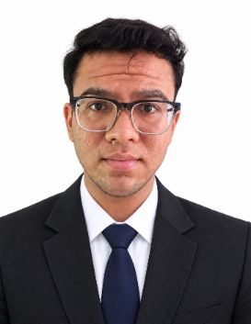
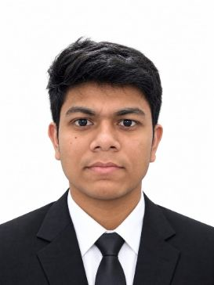
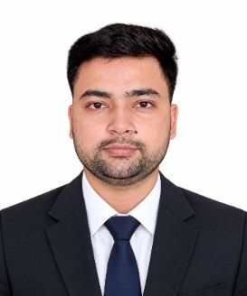
Project Title –Smart Salinity Ingress & Coastal Farmland Protection Advisor
Domain of Project – Agriculture & Coastal Resilience
Student Name | Recent Passport Photo | Email | Mobile number [WhatsApp]
Vyas Vraj Jayeshbhai. |  | vyasvraj1815@gmail.com | 9913003111
Desai Dhyan Nileshkumar |  | desaidhyan205@gmail.com | 9898027030
Darshan Bhaveshkumar Suthar |  | suthardarshan484@gmail.com | 7069825893

Slide 3
Problem Statement -Smart Salinity Ingress & Coastal Farmland Protection Advisor
Challenge – Smart Salinity Ingress & Coastal Farmland Protection Advisor
Domain: Agriculture & Coastal Resilience
The Challenge
Coastal districts of Gujarat such as Bhavnagar, Jamnagar, and Kutch face increasing seawater ingress into groundwater and farmland, degrading soil quality and reducing crop yields. Farmers lack timely, localized guidance on salinity-resistant crops and mitigation practices.
Objective
Build Agentic AI solutions that monitor soil and groundwater salinity trends, recommend salttolerant crop alternatives, and guide farmers on land reclamation and irrigation practices.
Suggested AI Agents
• Soil & Groundwater Salinity Monitoring Agent
• Salinity-Resistant Crop Advisory Agent
• Irrigation & Land Reclamation Planning Agent
• Farmer Alert & Advisory Agent
• Coastal Farmland Health Dashboard Agent
Technology to be used – IBM Bob + IBM Granite LLM + IBM cloud

Slide 4
PROPOSED SOLUTION : Smart Salinity Ingress & Coastal Farmland Protection Advisor
Salinity Shield AI: An AI-Powered Coastal Farmland Intelligence & Early-Warning System
Salinity Shield AI is a smart agricultural decision-support platform designed to help farmers and agricultural authorities detect, predict, understand, and manage soil salinity in coastal farmland. The system combines IoT/sensor data, AI analytics, geospatial risk mapping, forecasting, alerts, and actionable recommendations to prevent salinity from reducing soil quality, crop productivity, and long-term farmland sustainability.
1. Problem Addressed
Coastal agricultural regions, particularly areas of Gujarat, face increasing risks from:
Seawater intrusion
Rising soil salinity
Saline irrigation water
Poor drainage and waterlogging
Irregular rainfall
Excessive irrigation
Changing climatic conditions
Gradual degradation of agricultural soil
Reduced crop productivity
Lack of timely and understandable information for farmers
The major challenge is that soil salinity often becomes visible only after significant damage has already occurred.
Farmers may have sensor readings or agricultural data, but raw values such as EC (Electrical Conductivity), soil moisture, pH, and temperature do not directly tell them:
What is happening?
Why is it happening?
What will happen next?
And what should I do now?
Salinity Shield AI converts these raw agricultural signals into understandable risk scores, predictions, explanations, alerts, and recommended actions.

Slide 5
2. Proposed Solution
The platform creates a digital intelligence layer for every farm.
Data → Detection → Risk Analysis → Prediction → AI Explanation → Action → Monitoring
The system continuously analyses farm conditions and determines:
Current soil salinity level
Salinity risk
Rate of salinity change
Farm health
Whether conditions are improving or worsening
Possible causes
Future salinity risk
Suitable intervention
Expected outcome of an intervention
This allows farmers to move from reactive farming to predictive and preventive farming.
3. Core System Modules
A. Smart Farm Registration
Farmers can add individual farms with information such as:
Farm name
Location
Area
Crop
Soil characteristics
Irrigation information
Sensor information
Each farm receives its own digital farm profile.

Slide 6
B. Real-Time Soil Monitoring
The platform collects or simulates data from agricultural sensors such as:
Soil EC
Soil moisture
Soil temperature
pH
Water quality
Irrigation-related parameters
The system converts these readings into an easy-to-understand farm health status.
4. AI-Powered Salinity Risk Score
Every farm receives a dynamic Salinity Risk Score.
The score can combine:
Current EC
EC rate of change
Soil moisture
pH
Water quality
Historical readings
Weather conditions
Crop sensitivity
Location/coastal proximity
Previous salinity events
The result is categorized into:
Low → Moderate → High → Critical
This allows farmers and authorities to prioritize farms requiring immediate attention.

Slide 7
5. AI Early-Warning System
One of the most important components is early detection.
Instead of waiting until crops show visible damage, Salinity Shield AI detects abnormal trends such as:
EC increasing rapidly over several readings.
The platform can generate:
⚠️ Early Warning
“Salinity is increasing rapidly. Immediate intervention is recommended.”
This gives farmers an opportunity to act before severe crop and soil damage occurs.
6. Salinity Forecasting
The Salinity Forecast module predicts how salinity may change in the future.
It can analyze historical sensor readings and environmental factors to estimate:
Future EC
Future risk level
Expected trend
Potential critical period
Whether intervention is reducing the risk
7. AI Farm Advisor
The AI Farm Advisor acts as an intelligent agricultural assistant.
Farmers can ask questions such as:
“Why is my soil salinity increasing?”
“What should I do if EC is very high?”
“Which intervention should I take first?”
“Is my current crop suitable for this soil condition?”
The AI generates recommendations based on the farm's available data instead of providing only generic agricultural information.

Slide 8
8. AI Decision Trace
A major transparency feature is the AI Decision Trace.
Instead of giving farmers a recommendation without explanation, the platform shows:
Observation
EC has increased significantly.
Analysis
The current EC exceeds the selected crop/soil threshold.
Risk
Continued increase may negatively affect crop growth.
Recommendation
Take appropriate salinity-management measures.
Expected Result
Reduce salt accumulation and prevent further deterioration.
This makes the AI explainable and trustworthy.
9. What-If Simulator
The What-If Simulator allows users to test possible interventions before taking action.
For example:
What happens if irrigation is reduced?
What happens if freshwater irrigation is increased?
What happens if drainage is improved?
What happens if a salt-tolerant crop is selected?
The system compares:
Current Scenario vs. Proposed Scenario
and provides an estimated change in:
Salinity
Risk score
Farm health
Crop suitability
Long-term condition
This enables data-driven decision making rather than trial and error.

Slide 9
10. Live Risk Map
The platform provides a geospatial Live Risk Map showing farms and their current risk levels.
Authorities can quickly identify:
High-risk farms
Critical farms
Salinity hotspots
Geographical patterns
Farms requiring intervention
This transforms individual farm monitoring into a regional coastal-salinity intelligence system.
11. Alert Centre
The Alert Centre provides prioritized notifications when:
EC crosses a critical threshold
EC rises unusually quickly
Soil conditions deteriorate
Forecast predicts increasing salinity
Farm health drops
Immediate intervention is required
Alerts can be classified according to severity:
🔵 Informational
🟡 Warning
🟠 High Risk
🔴 Critical
This ensures that important problems are not buried inside large amounts of sensor data.

Slide 10
12. Farm Health Score
Each farm receives a simplified Farm Health Score /100.
The score can consider:
Soil salinity
Salinity trend
Soil moisture
pH
Crop condition
Historical health
Environmental conditions
Instead of requiring farmers to interpret multiple technical parameters, they receive a simple overall indicator.
13. Farm Intelligence Page
Selecting “View Farm Intelligence” opens detailed information for that specific farm.
It can contain:
Farm overview
Current EC
Historical EC graph
Soil parameters
Risk score
Farm health
Salinity trend
Forecast
Alerts
AI-generated explanation
Recommended actions
AI decision trace
What-if simulations
This provides a complete digital health record for each farm.

Slide 11
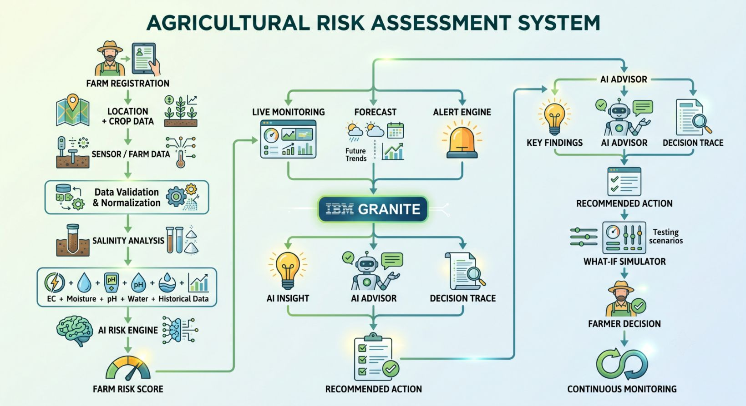
14. IBM Granite Integration
The platform can use IBM Granite as the generative AI intelligence layer.
Granite can help transform structured farm data into:
Natural-language explanations
Farm-specific insights
Recommendations
Decision reasoning
Risk summaries
Farmer-friendly responses
15. Complete System Workflow

Slide 12
TECHNOLOGY USED
IBM Agentic AI – Full-stack AI workflow orchestration for intelligent farm monitoring and decision-making.
IBM Granite – Multilingual reasoning, farm-health summarization, explainable insights, and recommendation generation.
IBM Cloud – Secure and scalable deployment infrastructure for Salinity Shield AI.
Grounded AI – Supplies real-time farm and sensor data as context to Granite for reliable, data-grounded recommendations.
Machine Learning – Predicts salinity risk using EC, moisture, pH, historical readings, crop, irrigation, weather, and coastal-location features.
Geospatial Intelligence – Interactive risk map showing farms, salinity hotspots, critical zones, and regional risk levels.
Predictive Analytics – Forecasts future salinity trends and enables early intervention.
Explainable AI – AI Decision Trace explains observations, risk assessment, and recommended actions.
What-If Simulation – Evaluates potential interventions and their impact on farm health and salinity risk.

Slide 13
Core Components Used –
Farmer Input – Interface for farm details, crop information, observations, and sensor/simulated sensor data.
IBM Granite Agent – Analyses farm conditions, summarizes salinity incidents, detects abnormal trends, and generates grounded recommendations.
IBM Granite Model – Provides multilingual understanding, reasoning, explanation, and AI-powered farm advisory.
AI Output – Displays risk explanations, farm-health summaries, forecasts, alerts, recommended actions, and AI Decision Traces.
Data Layer – Stores farms, sensor readings, EC, moisture, pH, historical data, risk predictions, alerts, recommendations, simulations, and audit logs.
Interactive Map & Dashboard – Visualizes farms, salinity-risk zones, hotspots, critical farms, sensor conditions, alerts, and regional coastal risk.
ML Prediction Engine – Predicts future salinity risk using sensor, historical, crop, irrigation, weather, and location data.
What-If Simulator – Evaluates potential interventions and their impact on salinity, farm health, and risk.

Slide 14
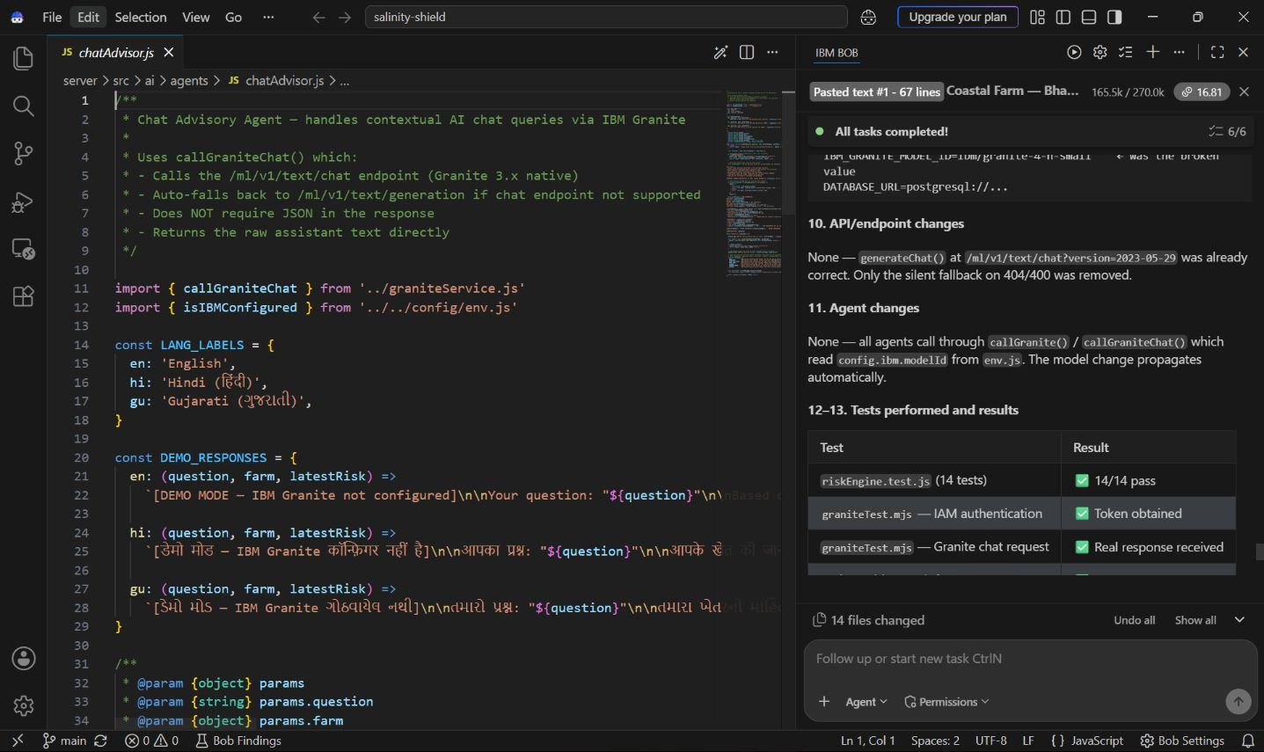
Required Files created using IBM bob -

Slide 15
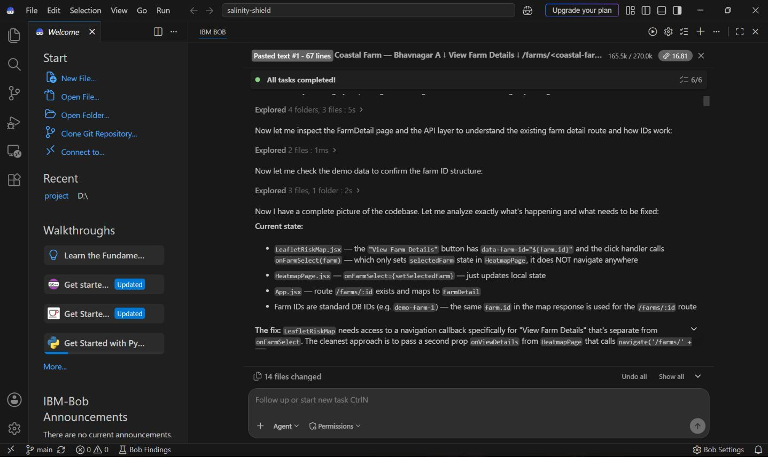
IBM Bob Screenshots:

Slide 16
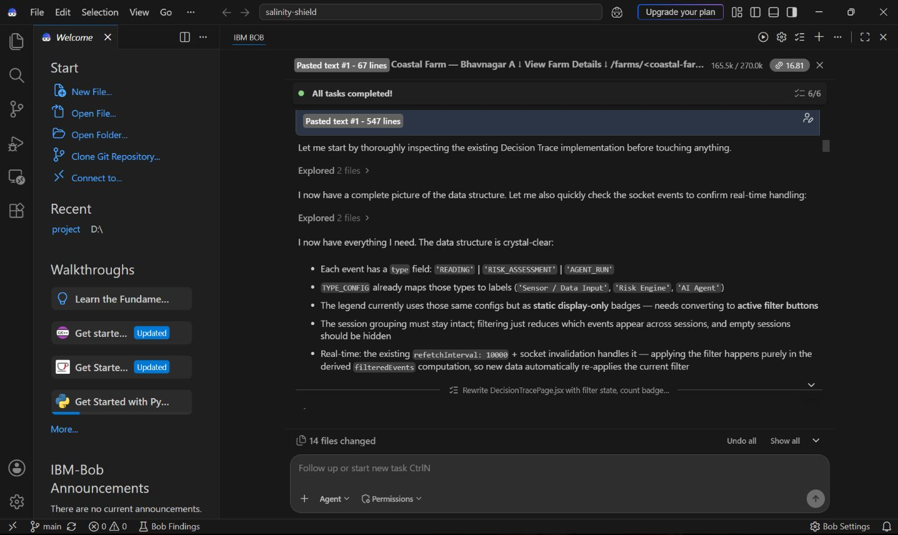
IBM Bob Screenshots:

Slide 17
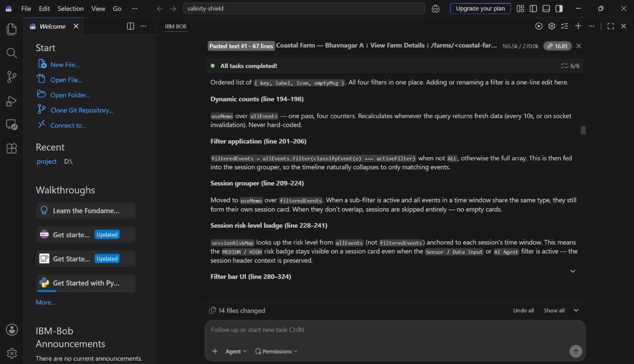
IBM Bob Screenshots:

Slide 18
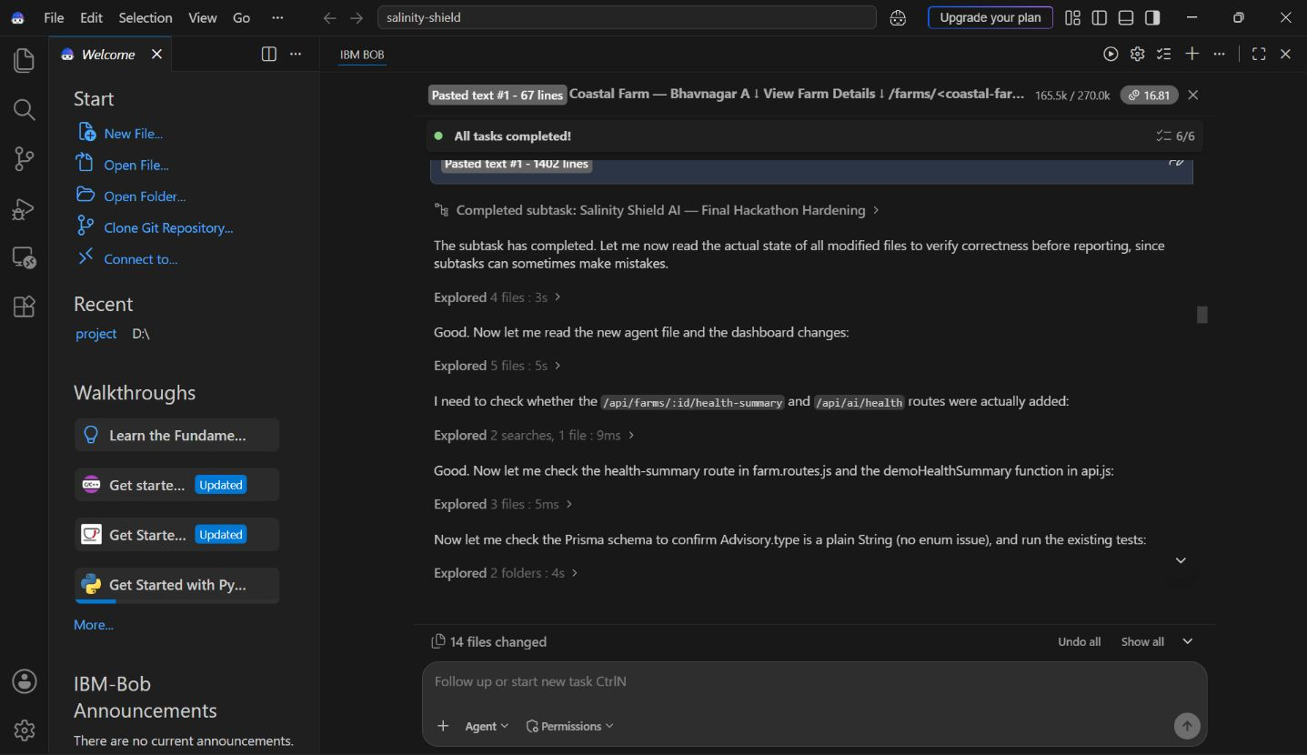
IBM Bob Screenshots:

Slide 19
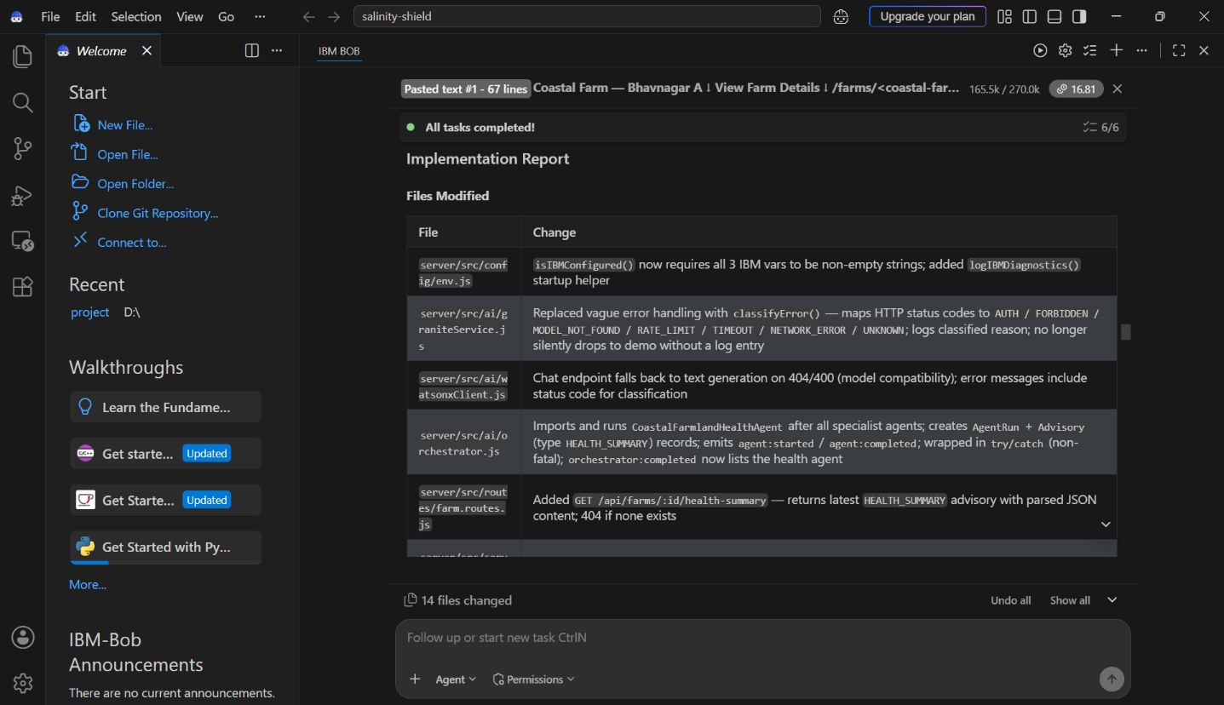
IBM Bob Screenshots:

Slide 20
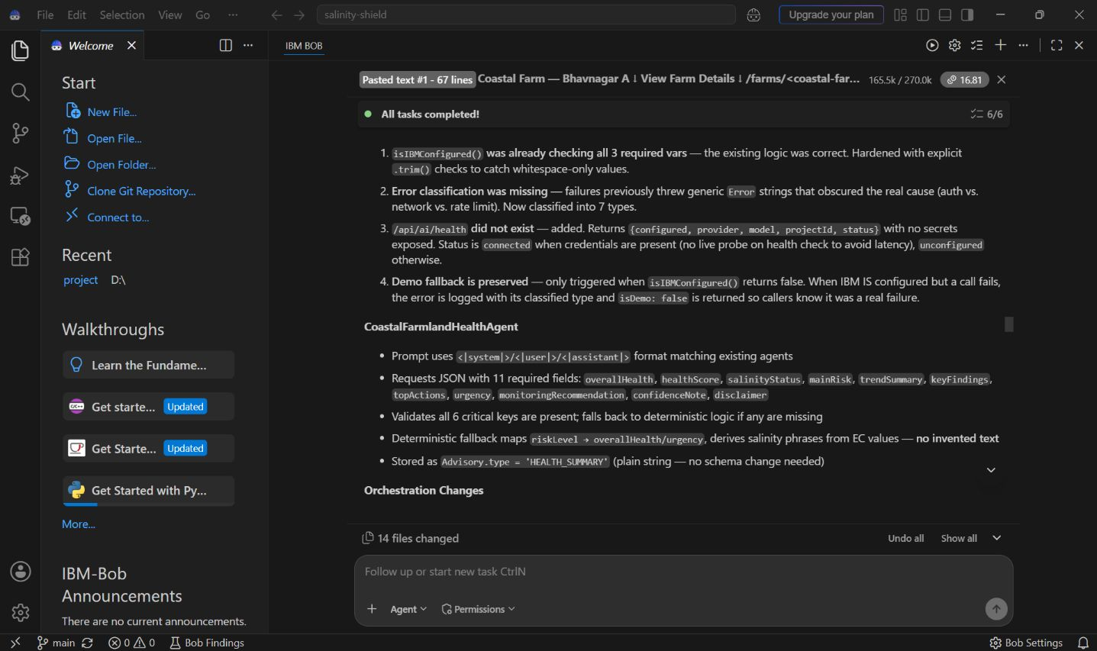
IBM Bob Screenshots:

Slide 21
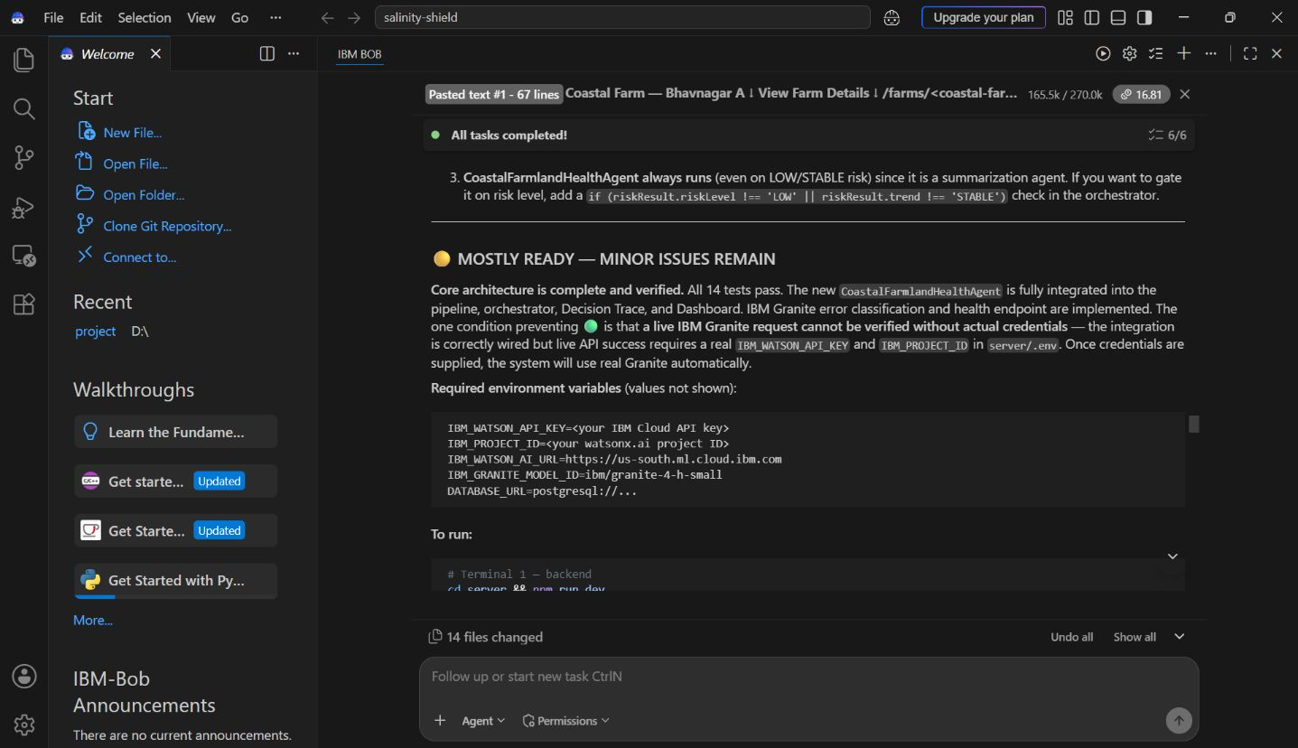
IBM Bob Screenshots:

Slide 22
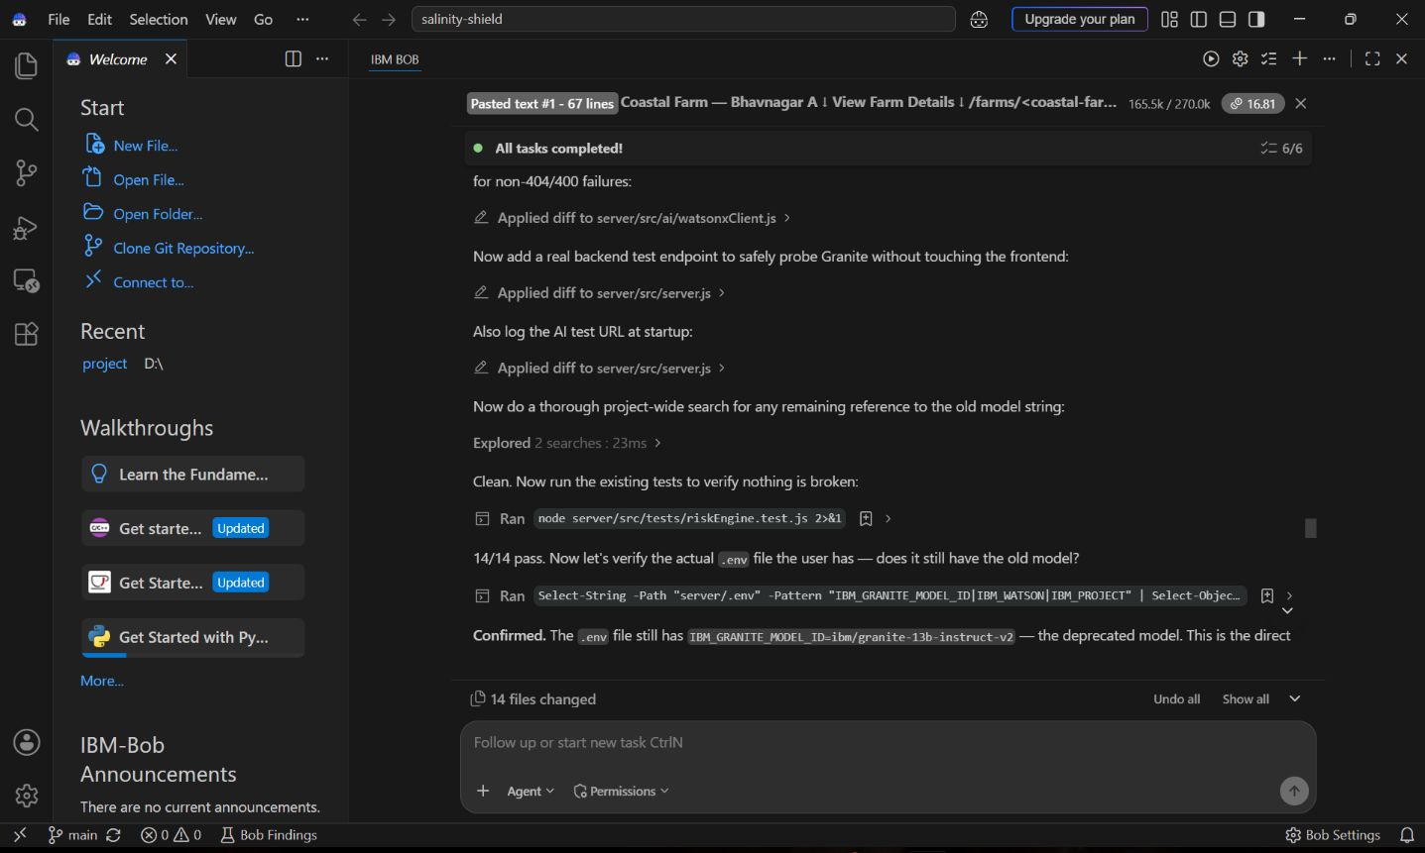
IBM Bob Screenshots:

Slide 23
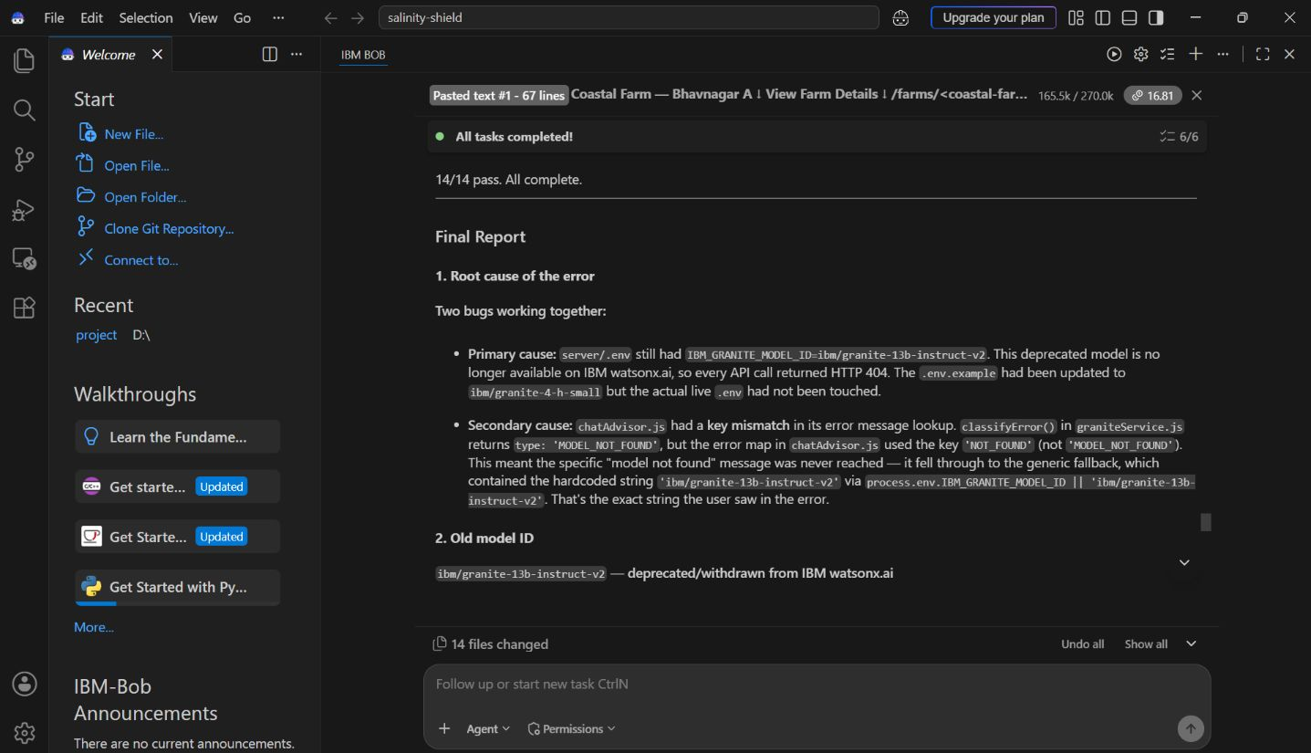
IBM Bob Screenshots:

Slide 24
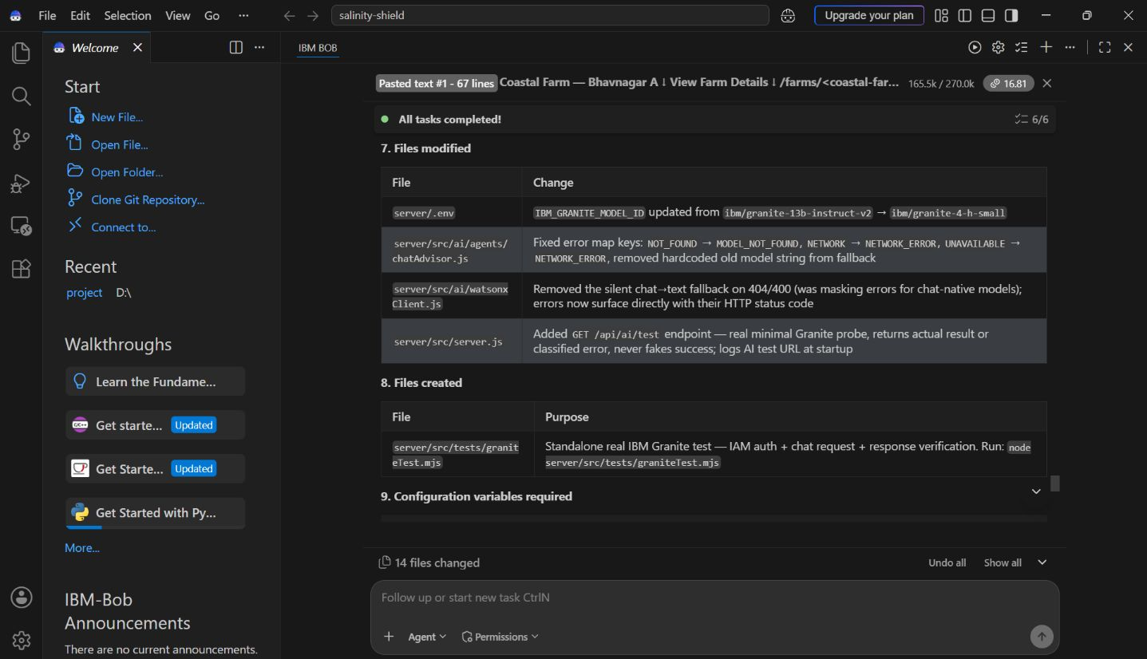
IBM Bob Screenshots:

Slide 25
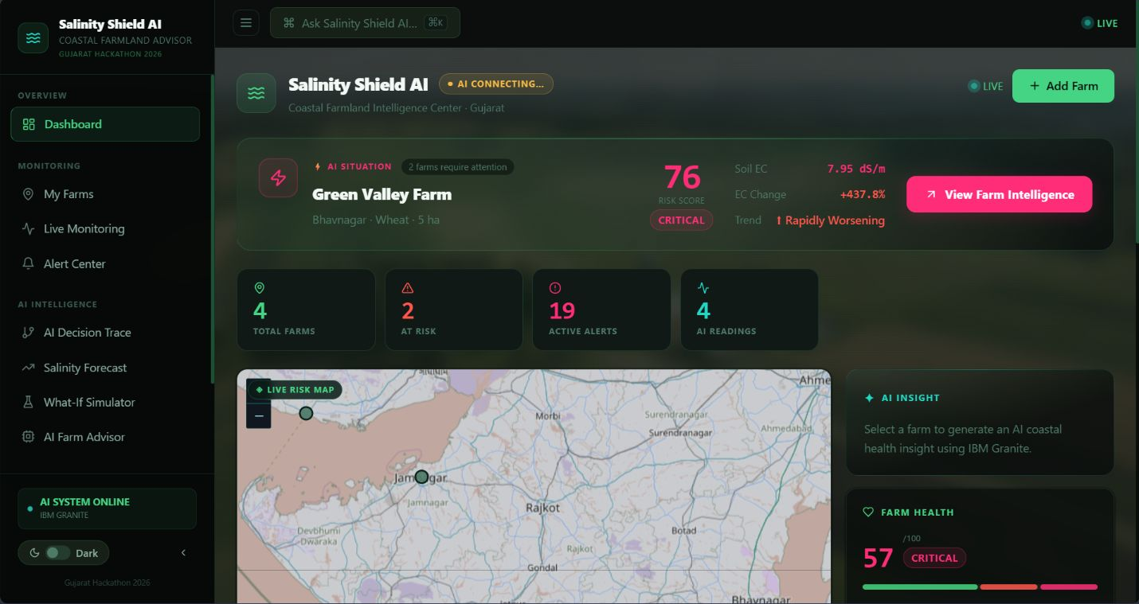
Project Output Screenshot

Slide 26
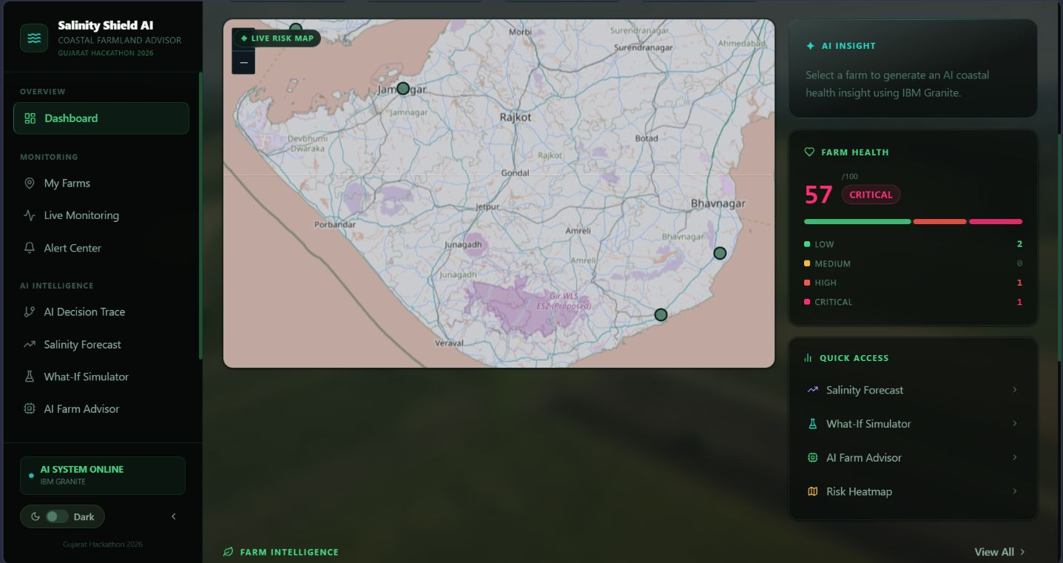

Slide 27
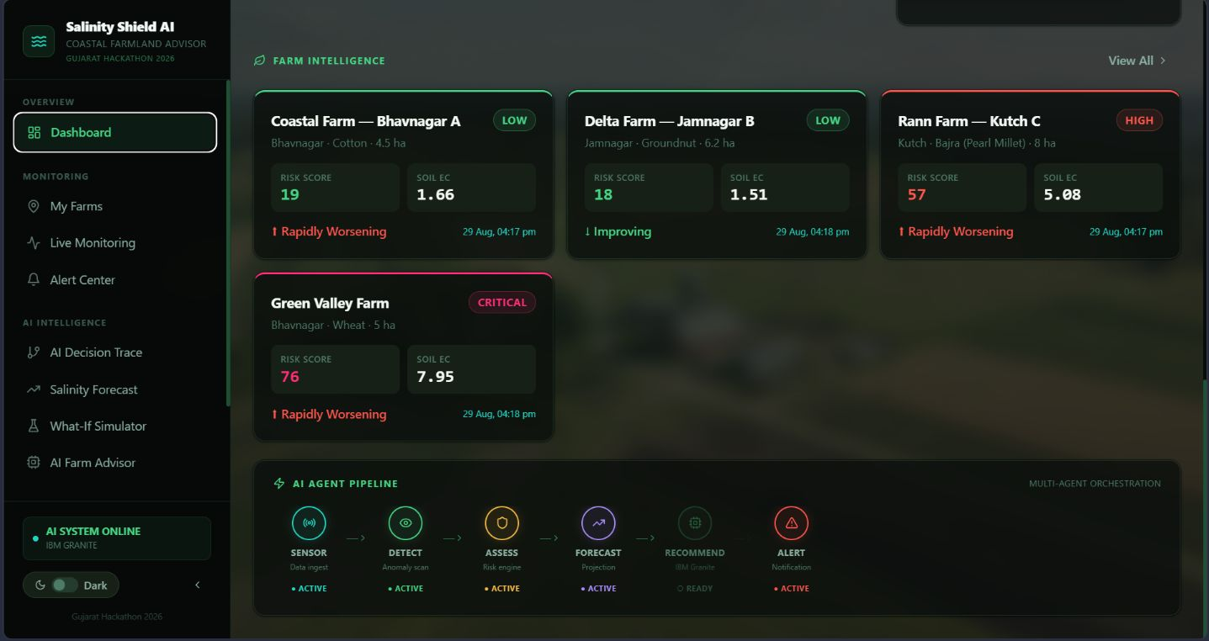

Slide 28
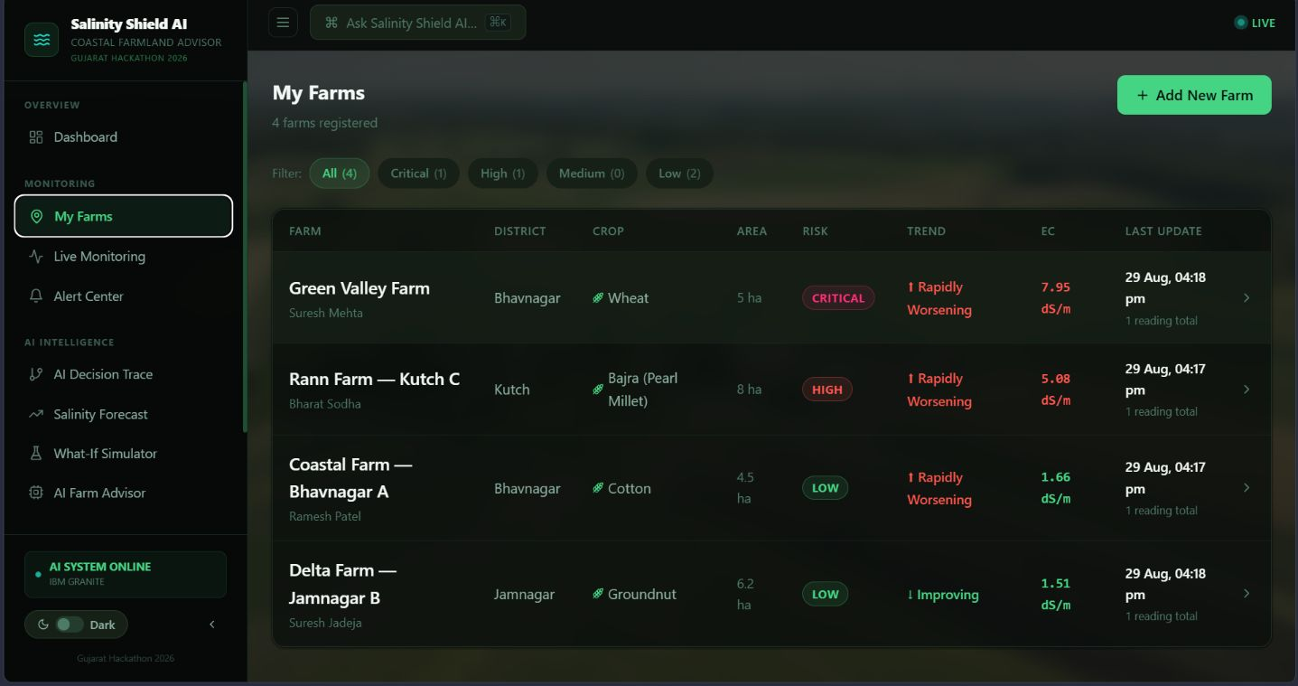

Slide 29
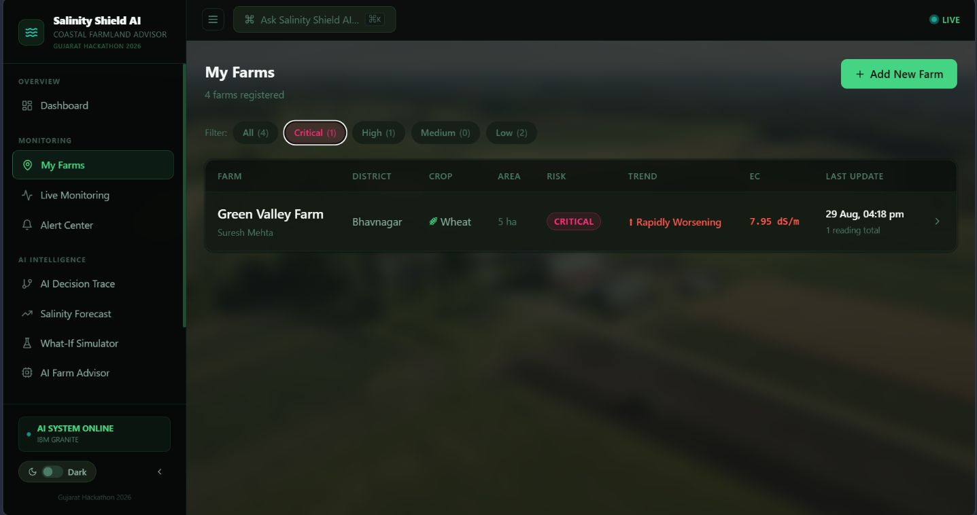

Slide 30
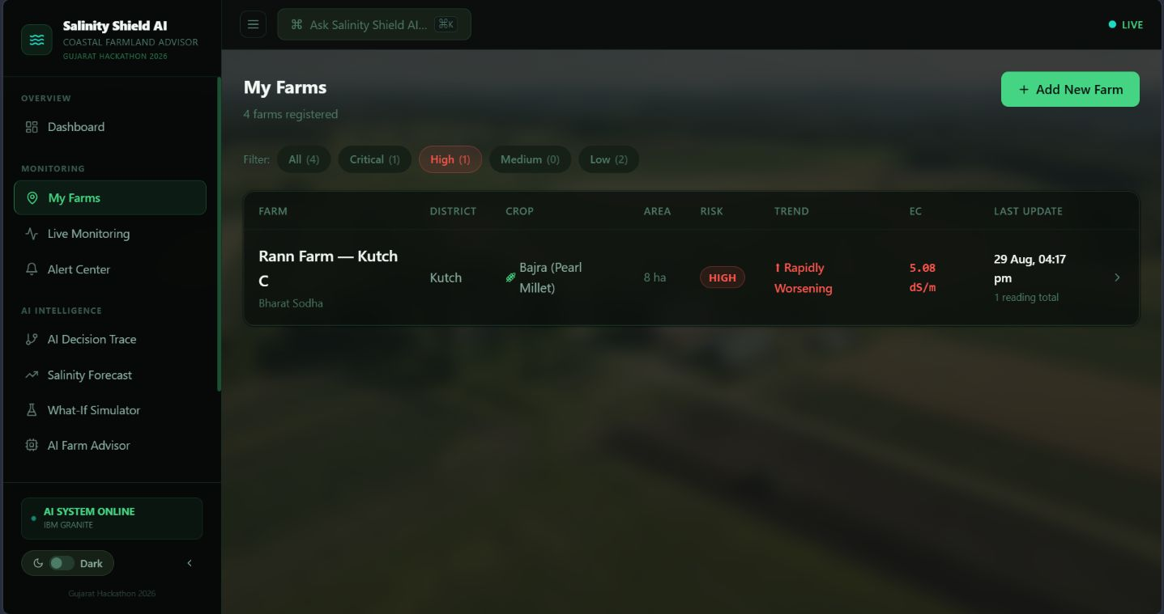

Slide 31
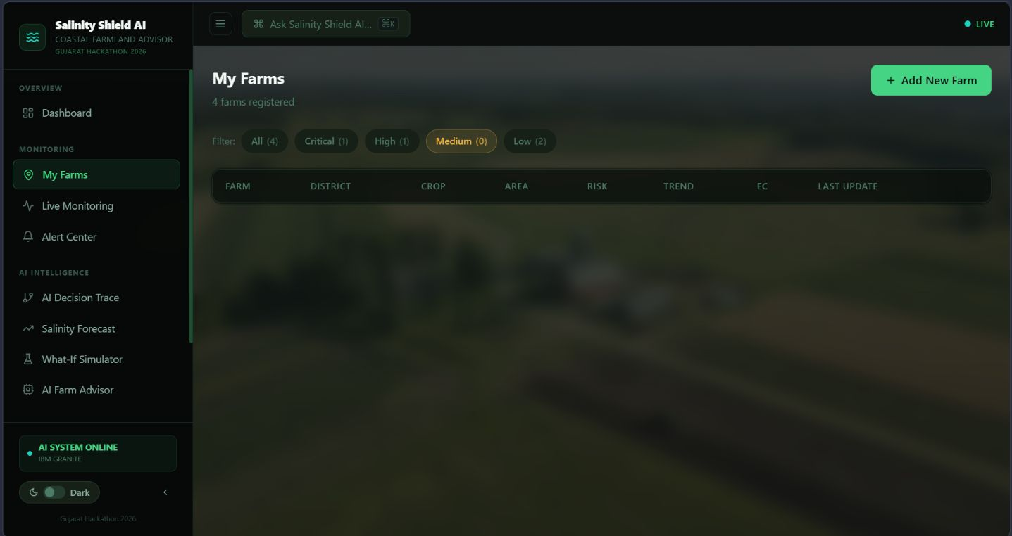

Slide 32
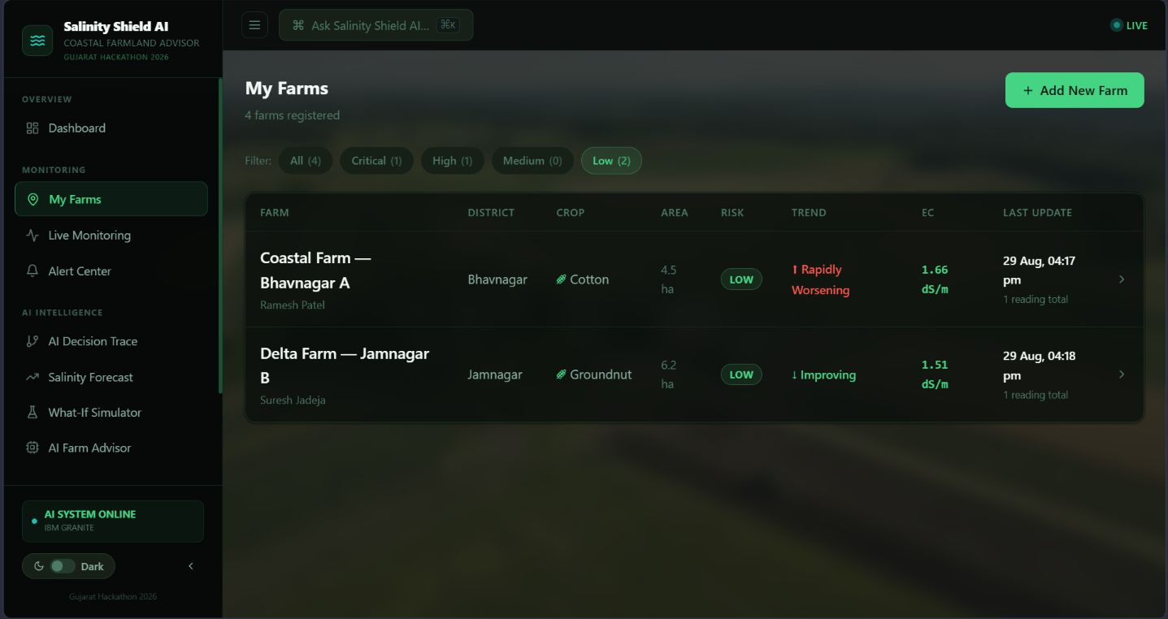

Slide 33
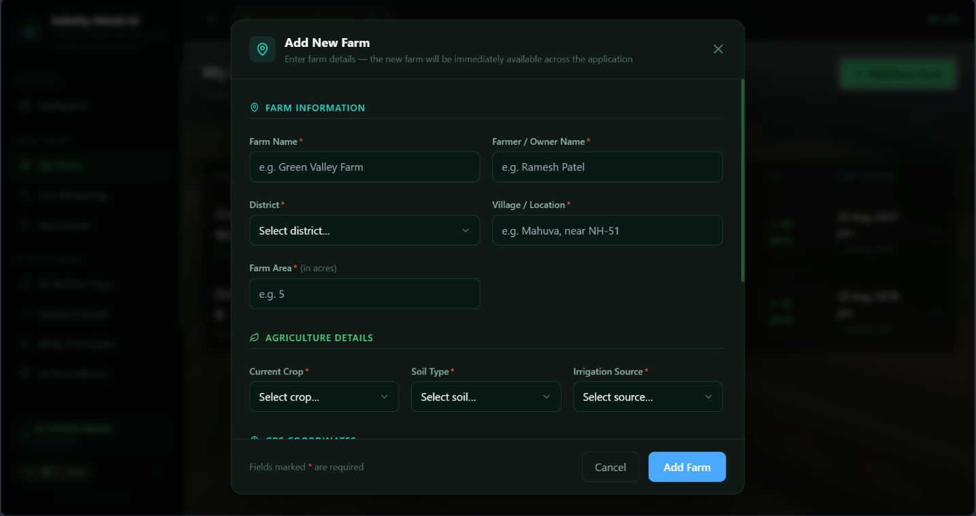

Slide 34
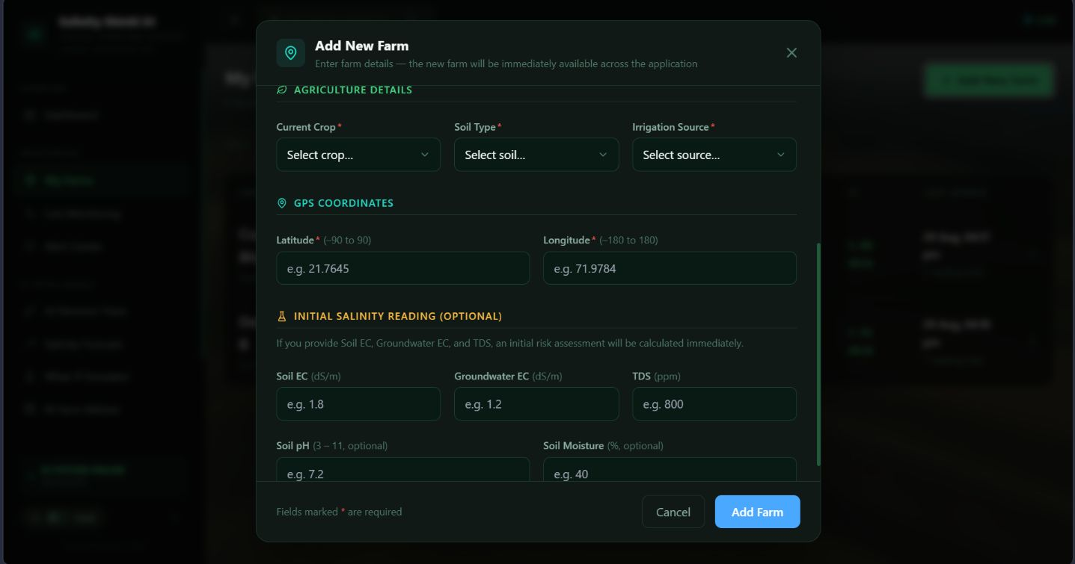

Slide 35
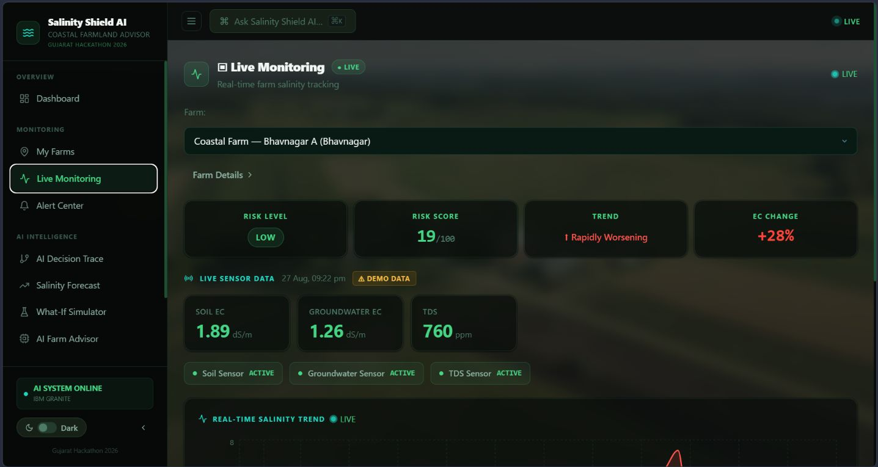

Slide 36
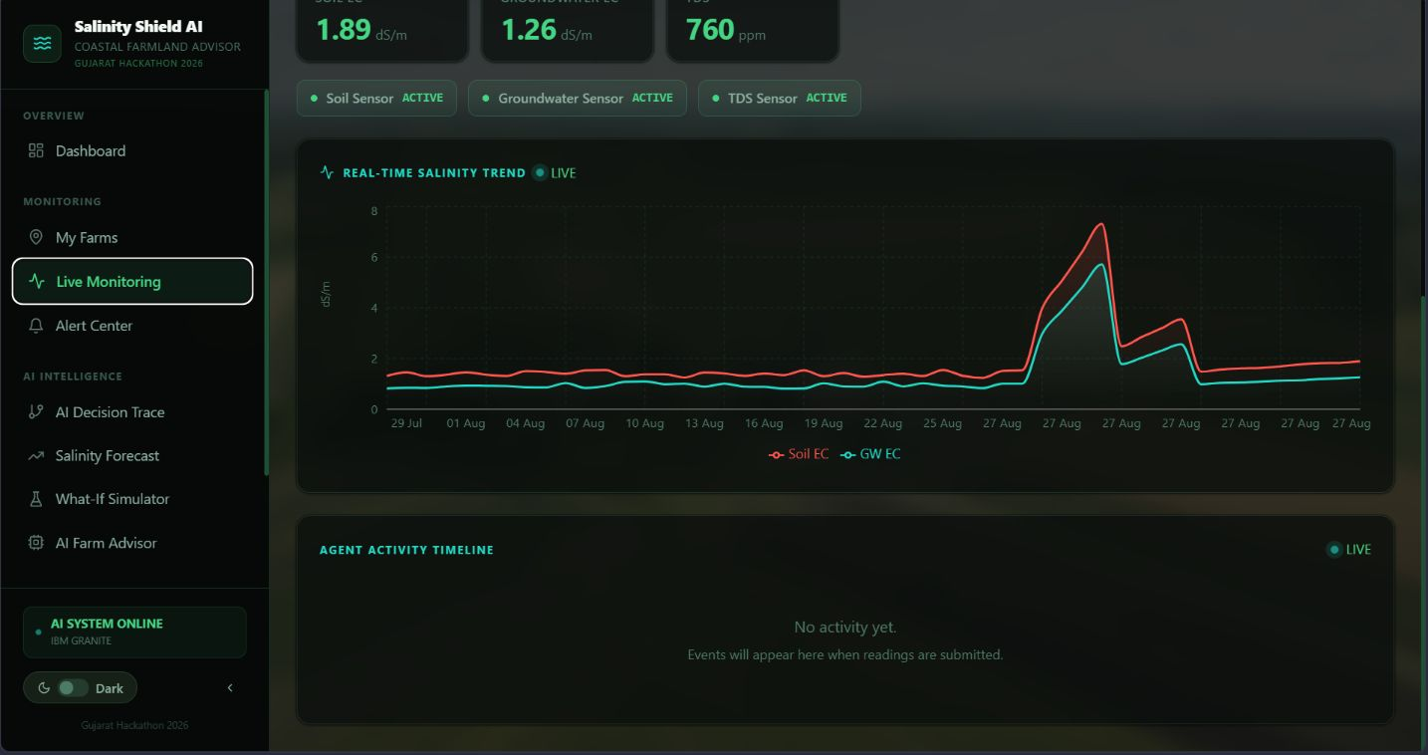

Slide 37
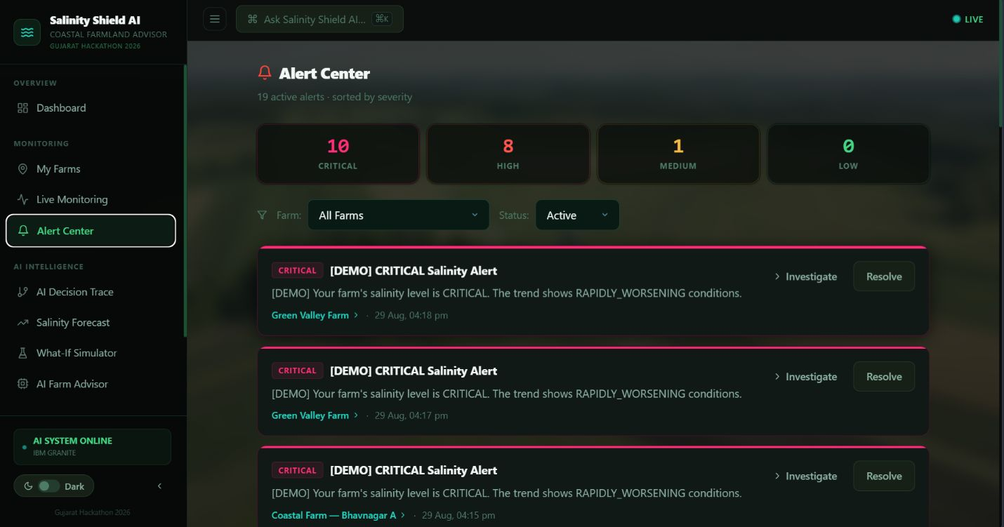

Slide 38
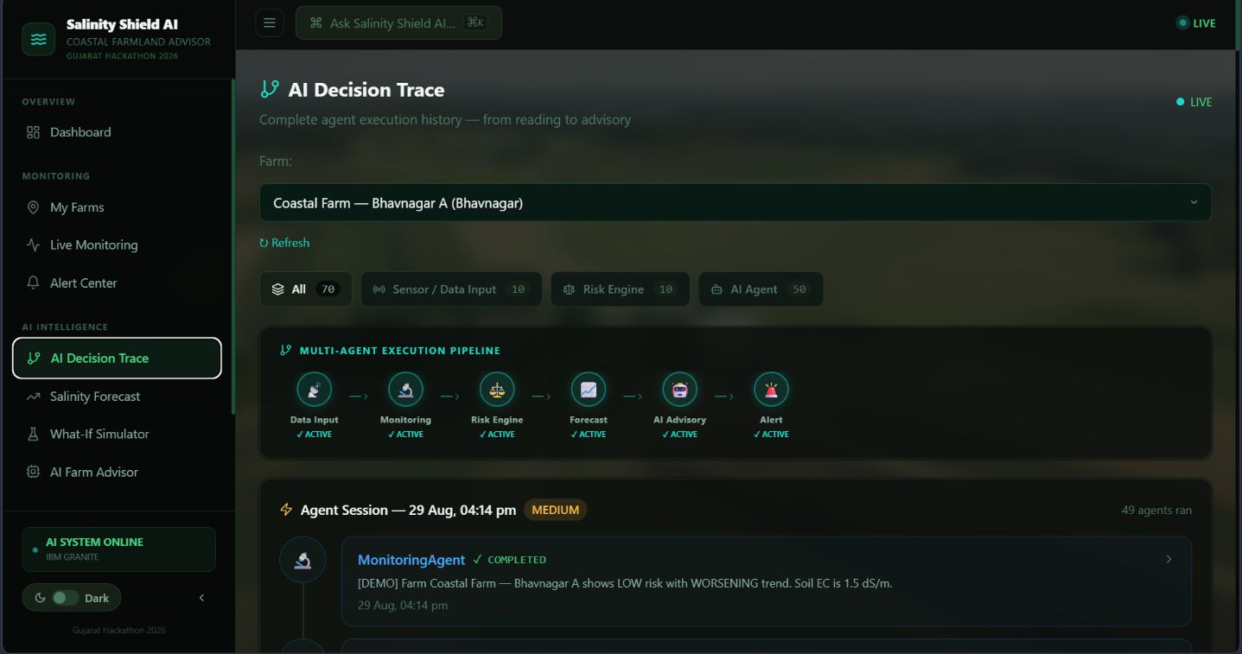

Slide 39
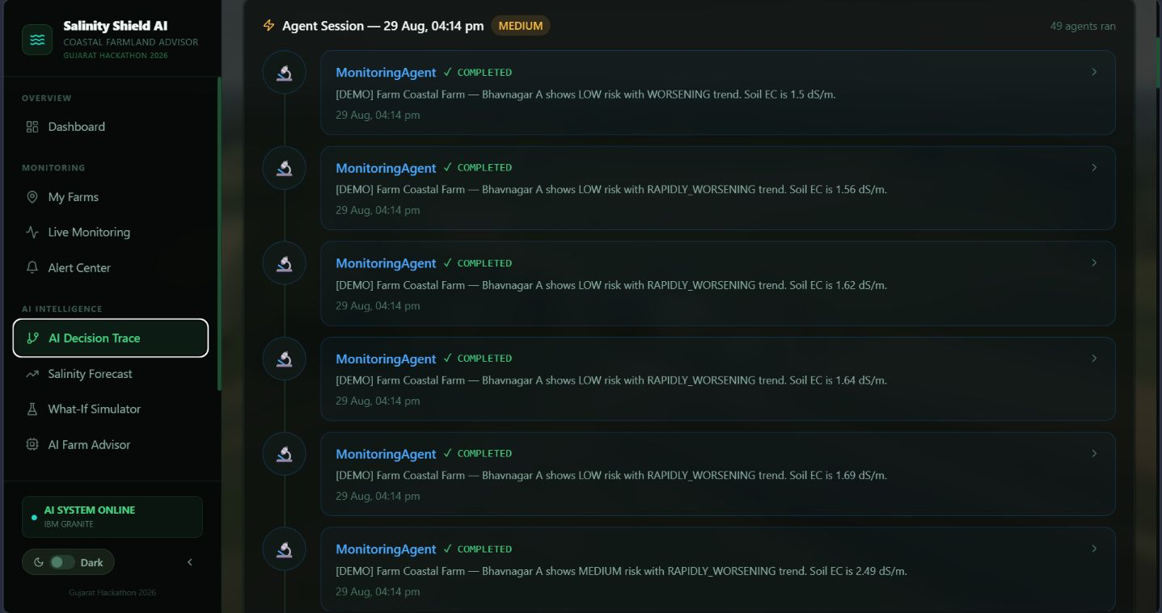

Slide 40
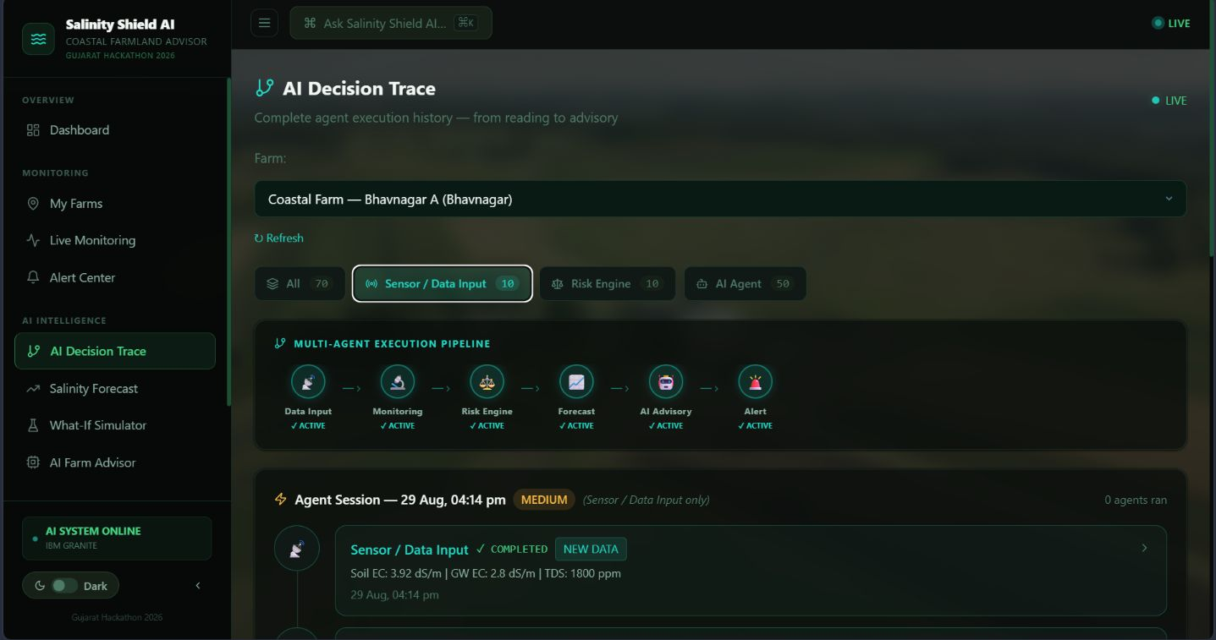

Slide 41
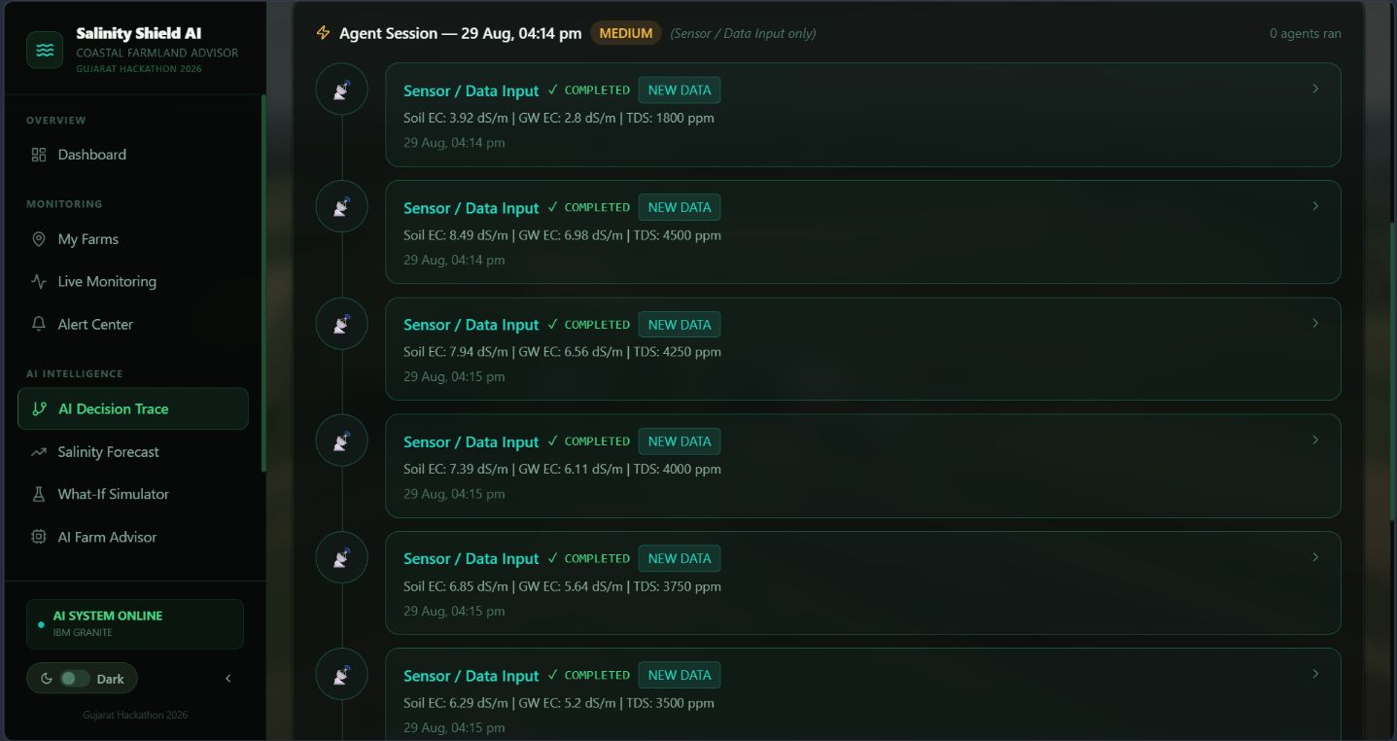

Slide 42
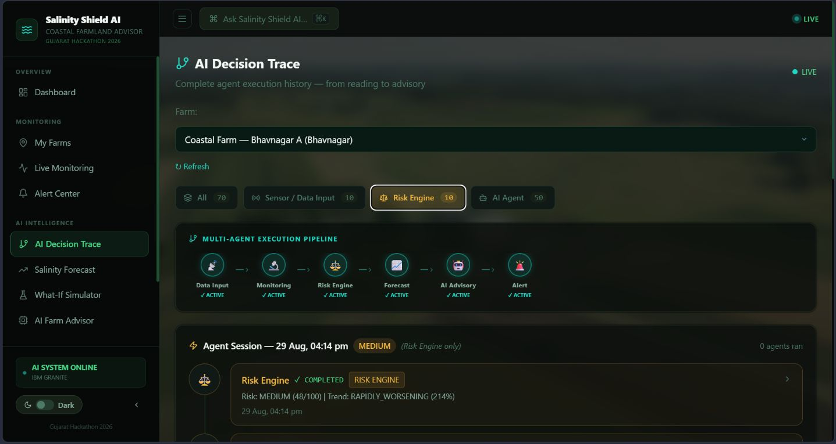

Slide 43
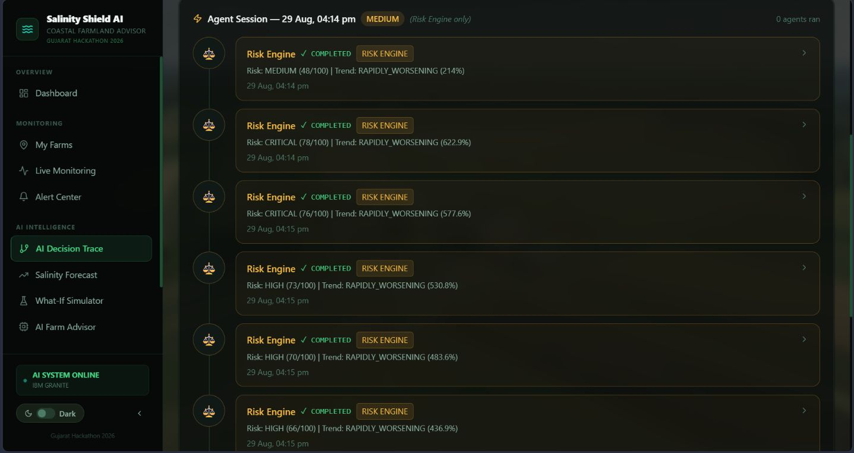

Slide 44
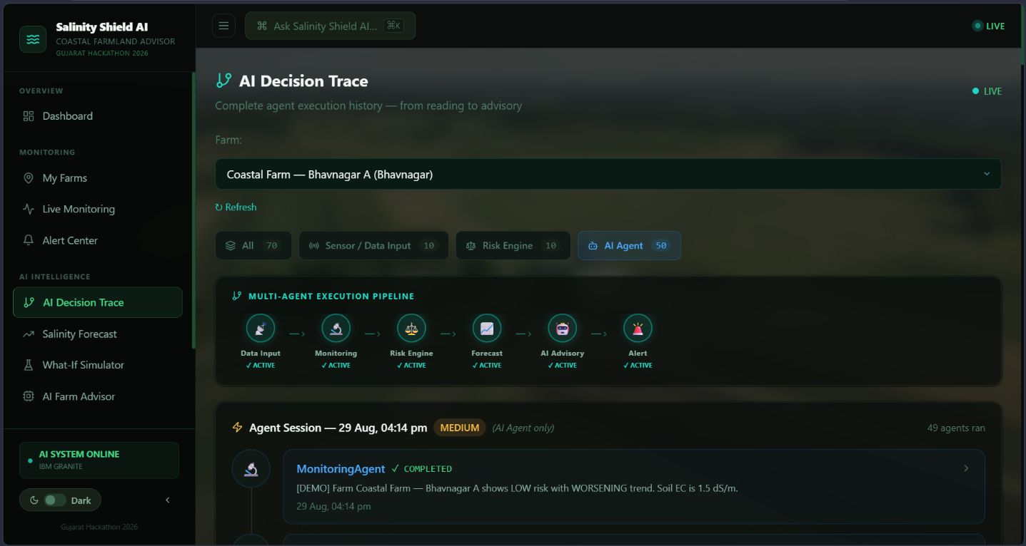

Slide 45
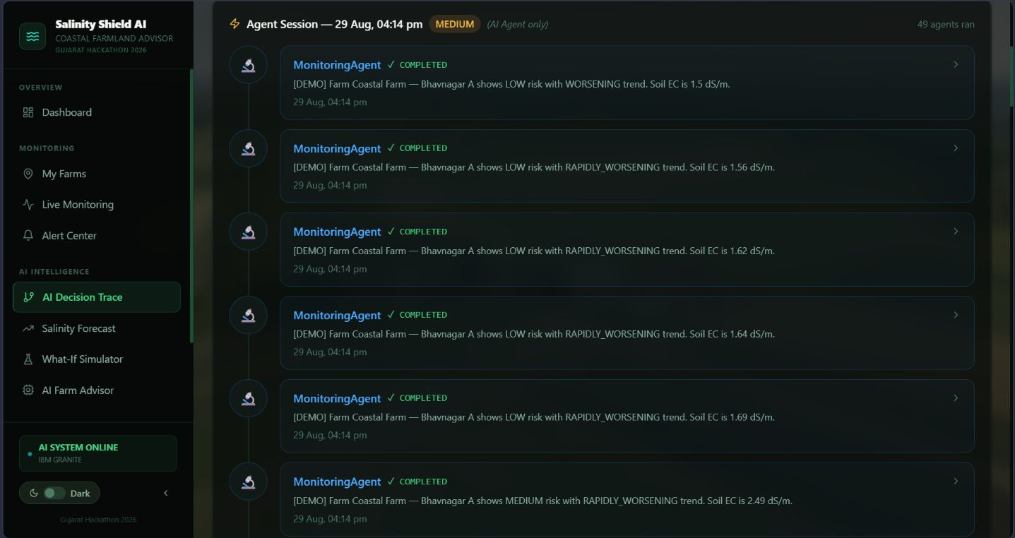

Slide 46
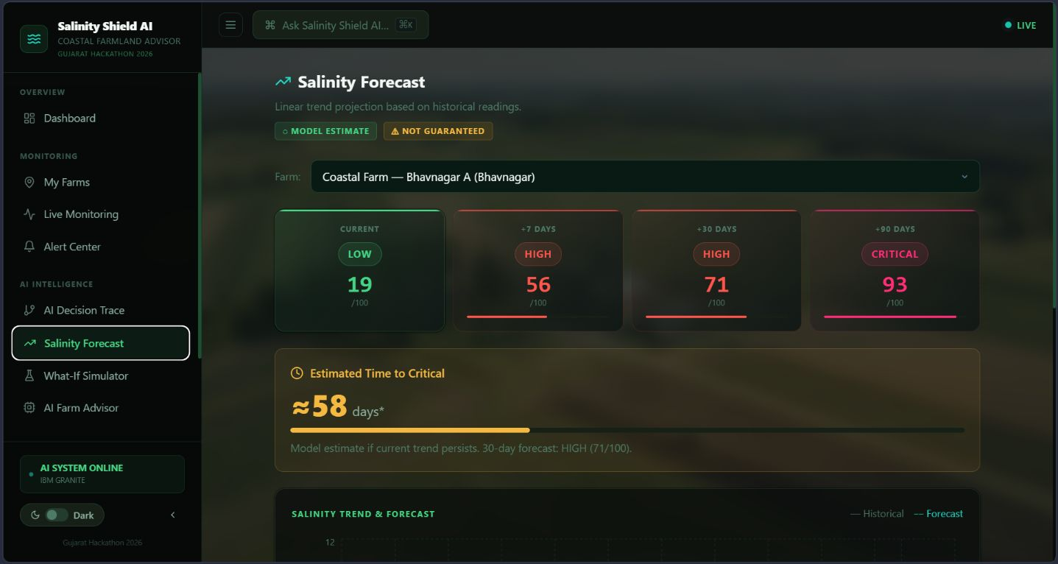

Slide 47
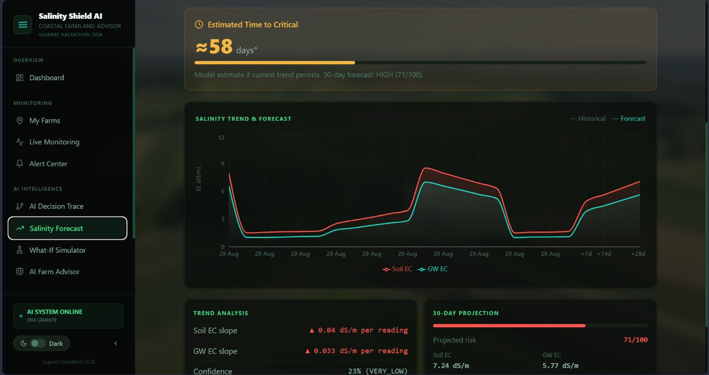

Slide 48
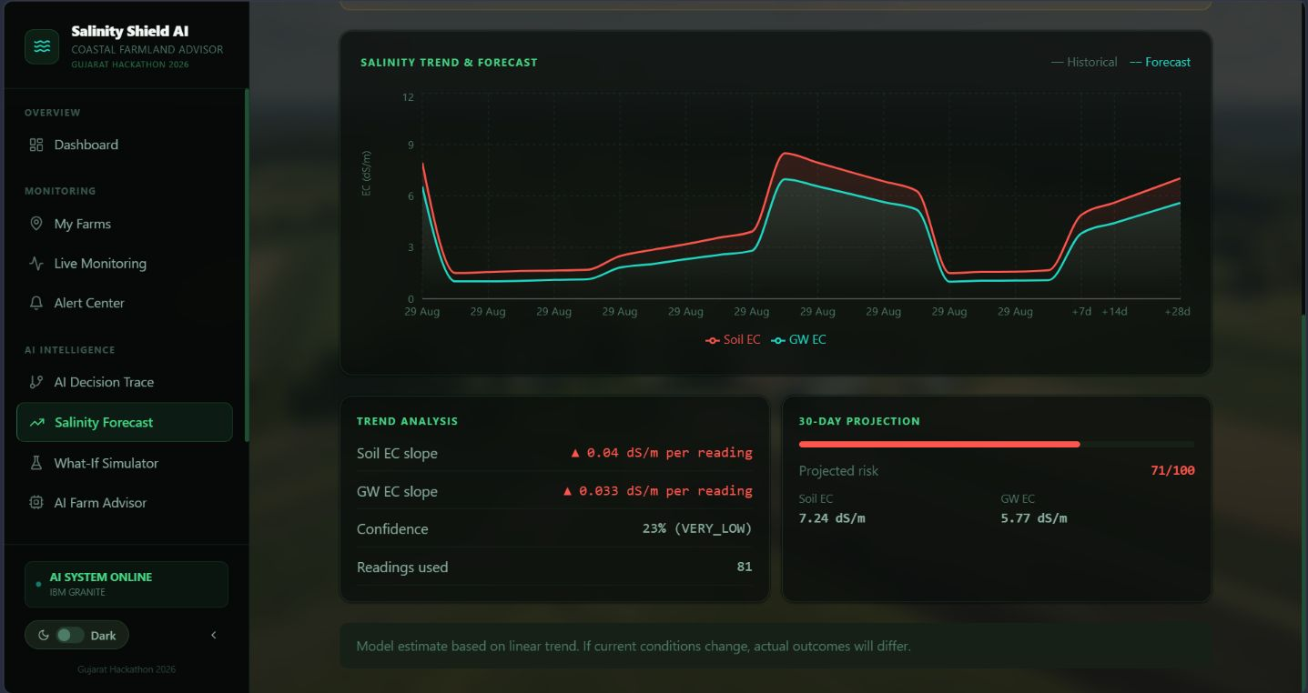

Slide 49
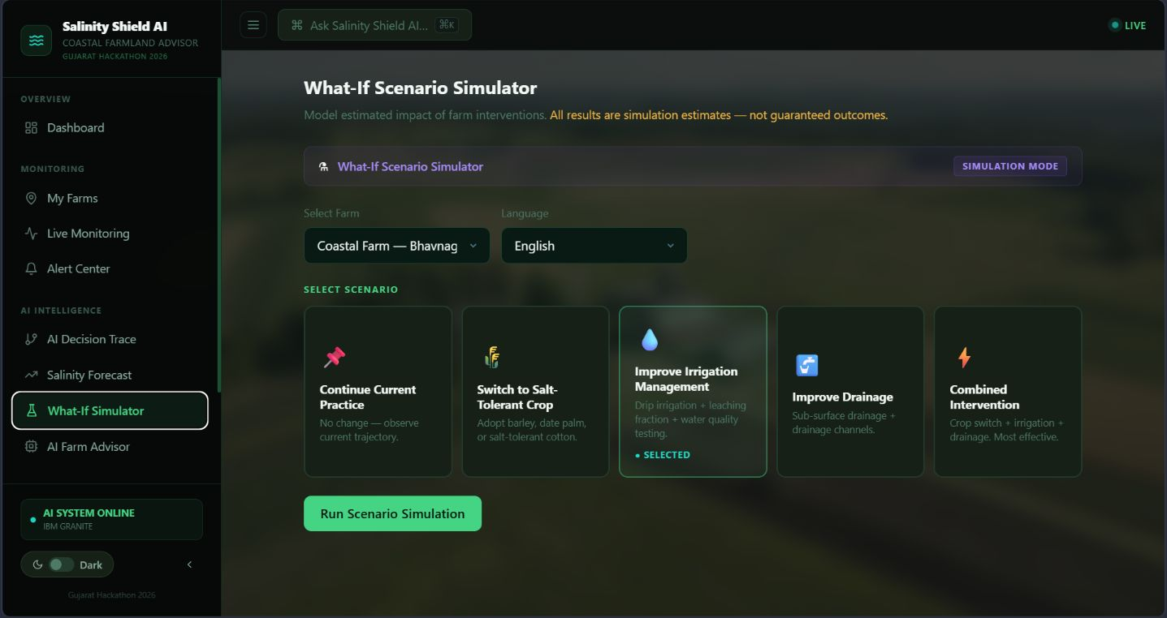

Slide 50
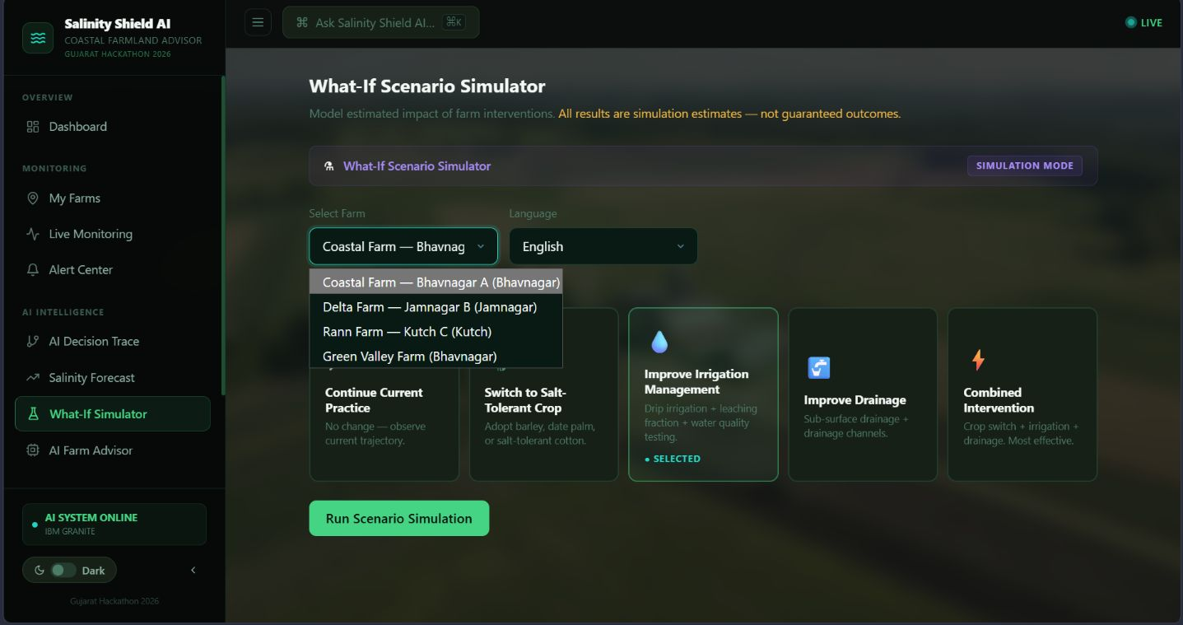

Slide 51
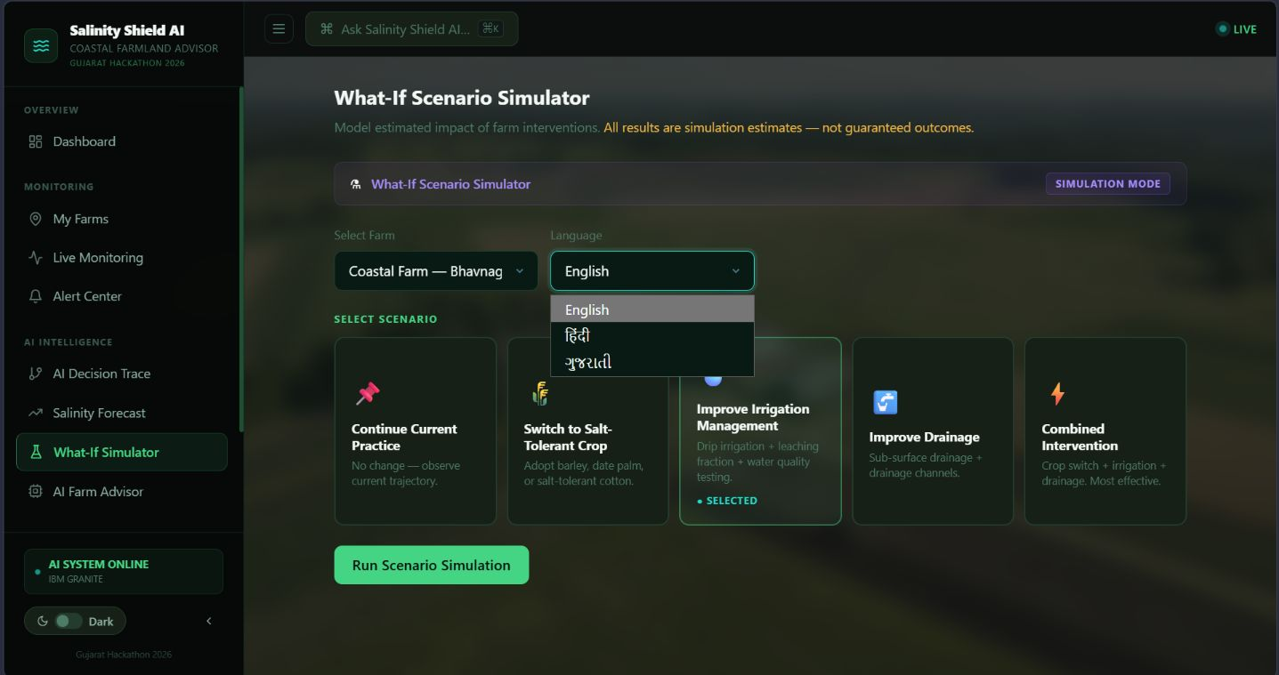

Slide 52
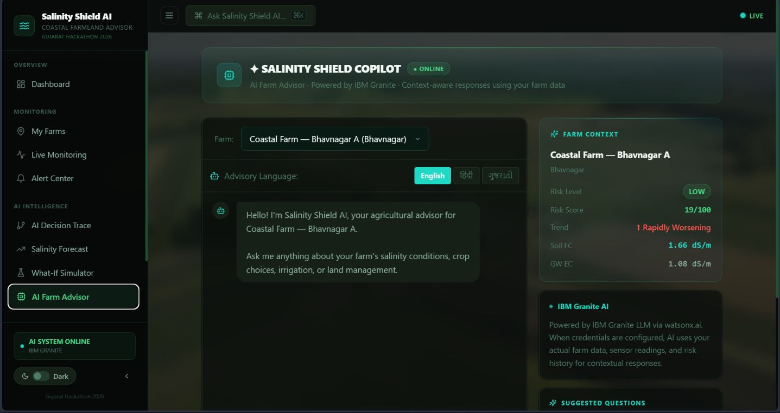

Slide 53
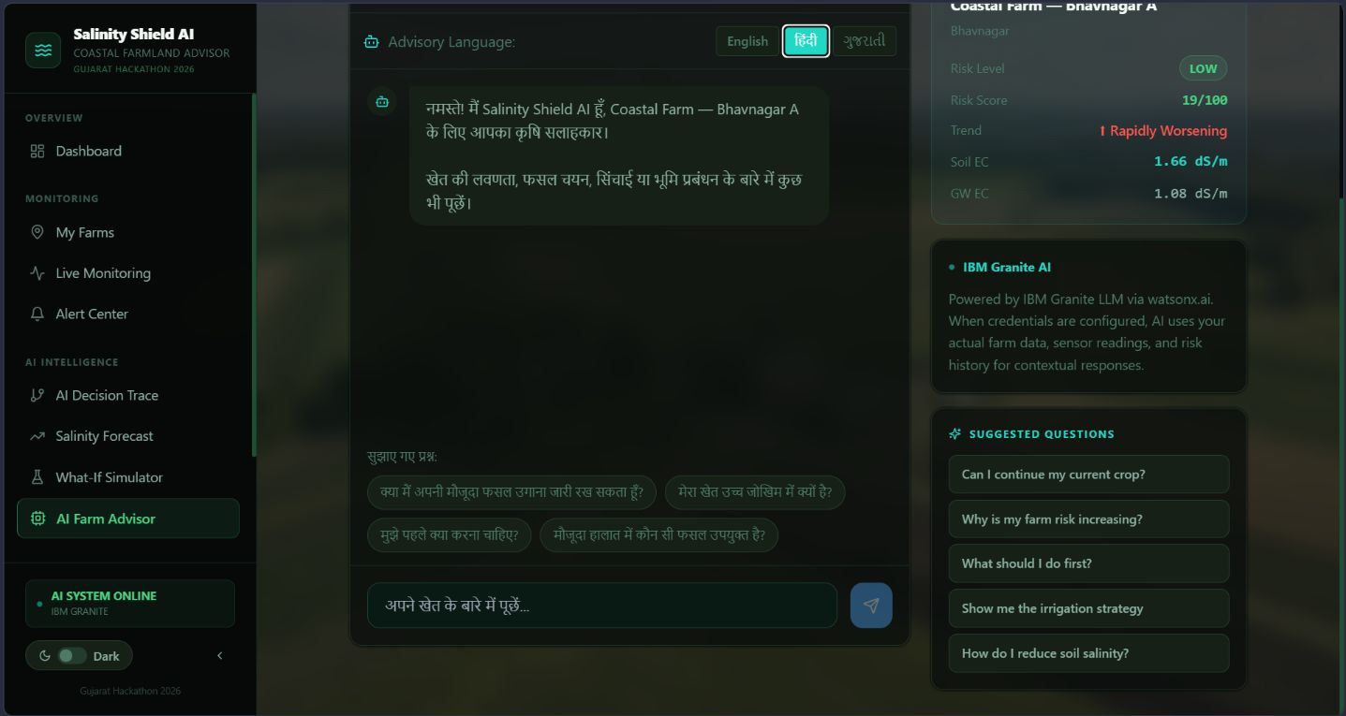

Slide 54
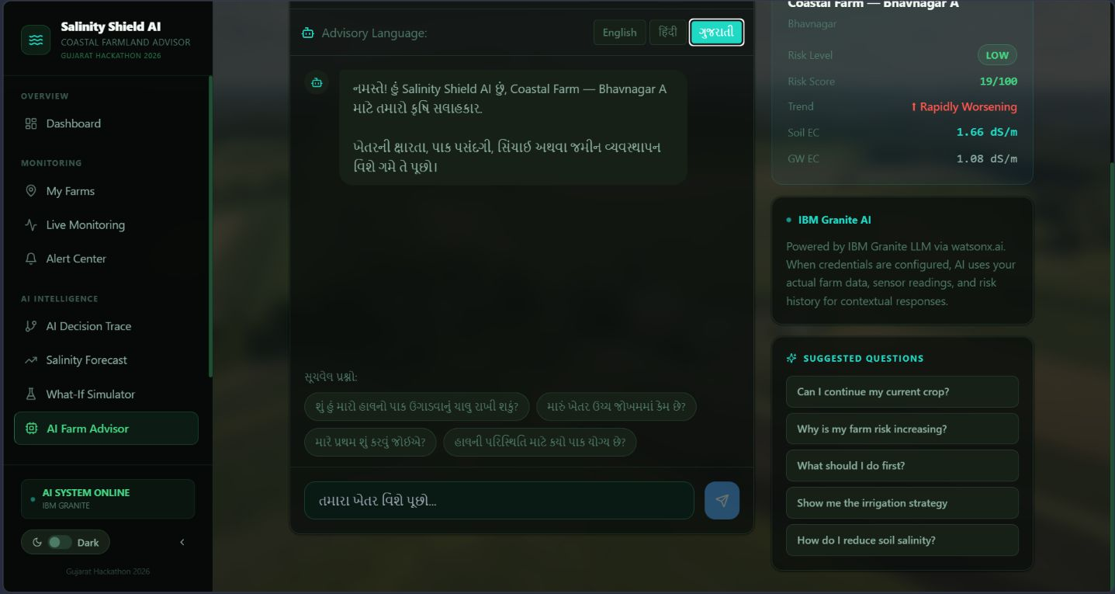

Slide 55
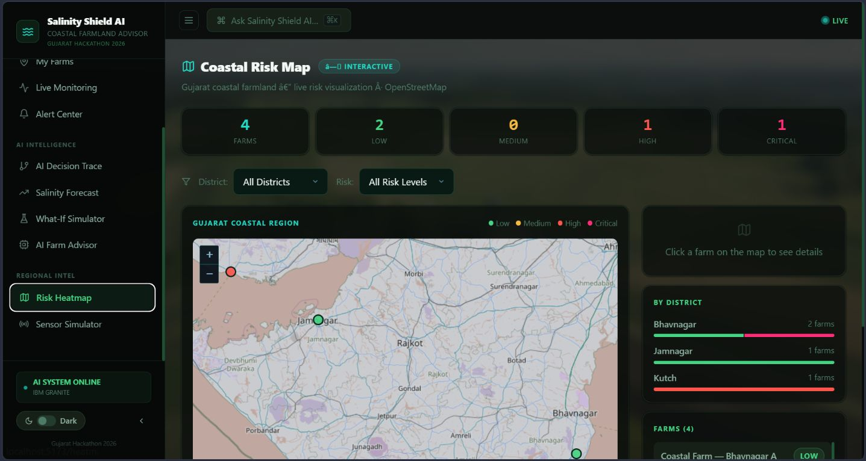

Slide 56
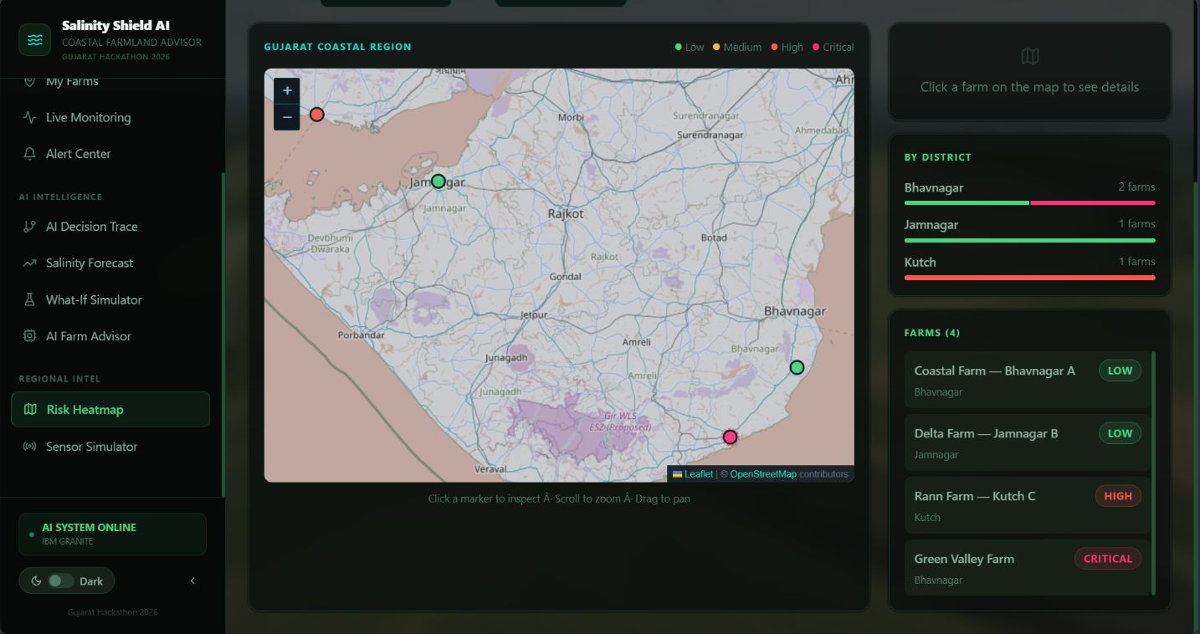

Slide 57
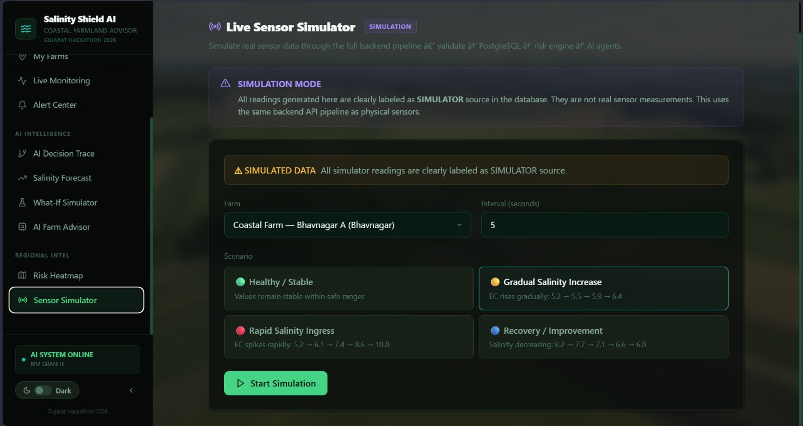

Slide 58
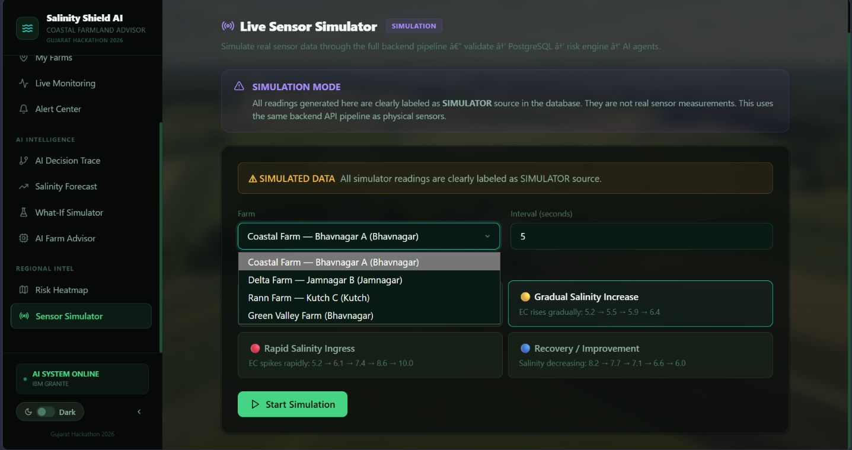

Slide 59
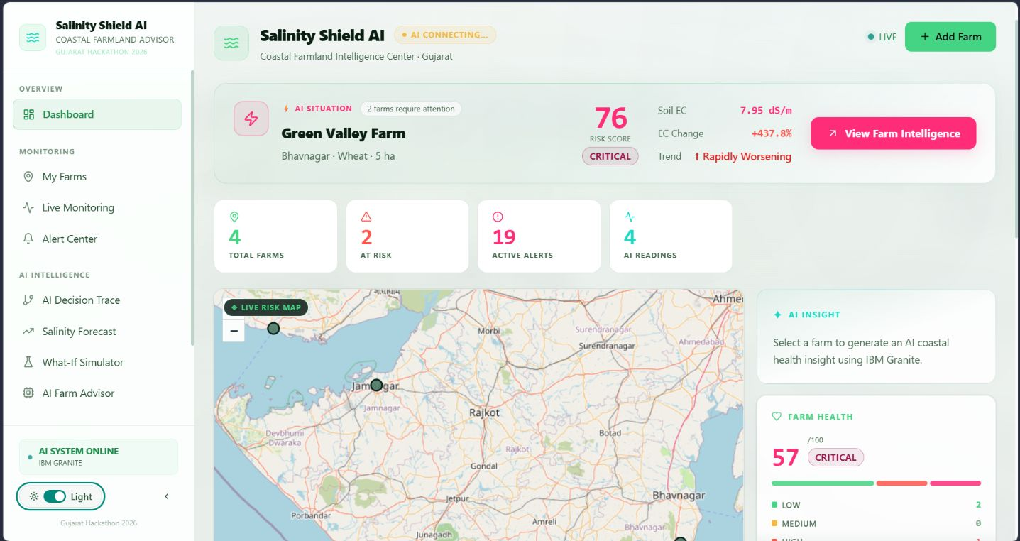

Slide 60

ROLE OF AGENTIC AI IN SOLUTION
Agentic AI transforms Salinity Shield AI into a coordinated, proactive agricultural decision-support system where specialized AI agents collaborate through an orchestration layer. Each agent performs a specific role:
Salinity Risk Prediction – Identifies current and changing soil-salinity risk levels using EC, moisture, pH, historical readings, crop conditions, irrigation, weather, and coastal-location data.
Farm Health Analysis – Evaluates overall farm health, identifies abnormal soil conditions, and determines whether the farm is improving, stable, or deteriorating.
Sensor & Trend Analysis – Continuously analyses incoming sensor data and detects unusual changes, rapid EC increases, threshold violations, and emerging salinity patterns.
Salinity Forecasting – Predicts future salinity levels and identifies farms that may move toward high or critical risk.
Farmer Query Understanding – Understands natural-language farmer questions and converts them into relevant farm-specific insights using available application data.
AI Recommendation Agent – Converts risk analysis and farm conditions into prioritized, practical recommendations for salinity management.
What-If Simulation Agent – Evaluates potential interventions and estimates how different actions could affect salinity, farm health, and future risk.
Geospatial Risk Agent – Analyzes geographical patterns and identifies salinity hotspots, vulnerable farms, and high-risk coastal zones.
Alert & Prioritization Agent – Determines the severity of detected conditions and prioritizes farms or situations requiring immediate attention.
IBM Granite Agent – Coordinates contextual reasoning, generates multilingual explanations, summarizes farm conditions, and produces grounded recommendations using application data.

Slide 61
Context-Aware Agentic Workflow
The system continuously updates its understanding as new sensor readings, farm observations, environmental information, historical data, and user inputs become available.
Through agent collaboration, Salinity Shield AI moves from:
Monitoring → Detection → Analysis → Prediction → Risk Prioritization → Recommendation → Human Decision → Intervention → Continuous Monitoring

Slide 62
NOVELTY AND UNIQUENESS
Salinity Shield AI combines Agentic AI, Machine Learning, Grounded AI, Geospatial Intelligence, Predictive Analytics, and multilingual farmer interaction to address the growing problem of soil salinity and seawater intrusion in coastal agriculture, with a focus on Gujarat's vulnerable farming regions.
Key Novel Features
Multi-Agent Intelligence – Specialized AI agents collaborate for salinity prediction, farm-health analysis, sensor monitoring, forecasting, recommendation, alerts, and decision support, instead of relying on a single chatbot.
Grounded AI Recommendations – IBM Granite uses real-time and historical farm data, sensor readings, crop information, and environmental context to generate reliable, farm-specific insights rather than generic recommendations.
Hyper-Localized Agriculture Intelligence – Designed specifically for Gujarat's coastal farming conditions, considering salinity, soil characteristics, irrigation conditions, crop sensitivity, and coastal vulnerability.
Predictive Salinity Protection – Uses Machine Learning to identify changing salinity patterns and forecast future risk, enabling intervention before severe soil and crop damage occurs.
Dynamic Risk Loop – New sensor readings and farm observations continuously update risk scores, forecasts, alerts, and recommendations, allowing the system to adapt to changing conditions.
Multilingual Farmer Assistance – Enables farmers to interact with the AI in Gujarati, Hindi, and English, making advanced AI-based agricultural intelligence more accessible.
Explainable AI Decision Trace – Unlike a black-box recommendation system, the platform explains the chain of observation → analysis → risk → recommendation, increasing transparency and trust.
What-If Decision Intelligence – Farmers and agricultural officers can test potential interventions and understand their possible impact on salinity, farm health, and future risk before taking action.
Geospatial Salinity Intelligence – Interactive maps identify salinity hotspots, high-risk farms, critical zones, and regional patterns, enabling targeted intervention instead of treating every farm equally.
Action-Oriented Decision Support – Converts complex sensor and prediction data into prioritized alerts, practical recommendations, and intervention guidance.
Scalable IBM Architecture – Built around IBM Granite, IBM Cloud, and agentic AI workflows, with modular components that can later integrate real IoT sensors, satellite data, weather information, and larger regional datasets.

Slide 63
GitHubLink
GitHub Repository :
Public GitHub Repository :
https://github.com/VyasVraj/-Smart-Salinity-Ingress-Coastal-Farmland-Protection-Advisor-.git
The repository contains the complete Smart Salinity Ingress & Coastal Farmland Protection Advisor project and submission materials.
Repository contents
SourceCode–CompleteStreamlitapplicationandprojectfiles
README.md–Projectoverview,setupinstructions,architecture,andusage
app.json–Applicationconfiguration
ProblemStatementPDF–Officialchallenge/problemstatement
ProjectPresentation PPTX–Final hackathon presentation
WorkingGitHub URL :
https://github.com/VyasVraj/-Smart-Salinity-Ingress-Coastal-Farmland-Protection-Advisor-.git
Google Drive link for 3-minute video :
https://drive.google.com/drive/folders/13DJwawwS5bvLA_B9uzODMZjDSDXbYYIb?usp=drive_link
·

Slide 64
FUTURESCOPE
Real-Time IoT Integration – Connect the platform with real soil and water sensors for continuous monitoring of EC, pH, moisture, and other parameters.
Satellite & Remote Sensing – Integrate satellite imagery to detect large-scale salinity hotspots and monitor changes in coastal agricultural land.
Advanced AI Forecasting – Improve prediction of future salinity and seawater-intrusion risks using long-term weather, groundwater, and environmental data.
Personalized Crop & Irrigation Recommendations – Recommend suitable salt-tolerant crops and optimized irrigation strategies based on individual farm conditions.
Regional Expansion – Scale from individual farms to district- and state-level salinity monitoring, helping government authorities plan targeted interventions.
Farmer Mobile & Voice Assistant – Extend the AI advisor into a mobile/voice-based system supporting Gujarati, Hindi, and English for easier access in rural areas.
·

Slide 65



IBM SKILLBUILD PROFILE :

Slide 66



Certificates Earned :

Slide 67



Certificates Earned :

Slide 68


